Slide 1


<Insert Picture Here>
11 Georaster

Slide 2
Georaster
Concepts
Storage Model
Loading Rasters
Raster Algebra and Analytics
Mosaicing and other processing
Raster Viewer
Third-party tools support

Slide 3
<Insert Picture Here>
GeoRaster Concepts

Slide 4
Raster/Vector Data Differences
Vector Data | Raster data
Precise coordinates define a point, line, or polygon Sparse representation of data (requires less storage) Good for representing map features Good for describing connectivity (topology) | One or more cells approximate a point, line, or polygon Requires storage of a complete matrix of cells Good for representing and analyzing large, filled structures Easily drawn, as each cell can correspond to one or more pixels Typically requires much more storage space
Notes:
Raster/Vector Data Differences
Vector data is defined using precise coordinates that can define a point, two or more points that define a line string, and three or more points that define a polygon. The coordinates can be sparse in line string or polygon. For instance, if a line is a straight line between two points, only the start and end points of the line are required. If a rectangle is stored, only the four coordinates at the corners can be used to define it. Vector data is good for representing and drawing map features, and is also well suited for describing connectivity relationships between objects in space.
Raster data uses cells that can be used to approximate points, lines, or polygons. The cells are part of a complete matrix, which requires data storage for every element in the matrix. Raster data is ideally suited for representing and analyzing data within a structure. Raster data is also easily displayed, as a raster cell can be mapped to one or more pixels.

Slide 5
Raster/Vector Data Differences
Vector Data
Vector Coordinates
Raster Data
-74.1651749, 41.339141
-74.1651749, 41.339141,
-73.4284481, 40.678193,
-72.9792214, 41.686228
-74.1651749, 41.339141,
-74.1651749, 39.559004,
-72.9792214, 39.559004,
-72. 9792214, 41.339141
Notes:
Raster/Vector Data Differences
This illustrates some of the differences highlighted in the previous slide. Points, lines, and polygons can be precisely defined in vector format, however in raster format they can be approximated using a matrix or grid. The storage requirement for vector data can be quite small, but in the case of raster data the entire matrix must be stored. In vector format, to draw data other than points the data between defined coordinates must be calculated and drawn. In raster format, the matrix can be mapped to a display, where each cell is mapped to a section of the display, and the value of that cell determines what will be displayed.

Slide 6
Resolution of Raster Data
The resolution of raster data is determined by the cell size
Fine resolution data is associated with smaller cells. It requires more storage, analysis requires more processing time, and information obtained may be more accurate
Coarse resolution data is associated with larger cells. It requires less storage, analysis requires less processing time, and information obtained may be less accurate
Notes:
Resolution of Raster Data?
Raster data has assigned values within a matrix that covers one or more objects. Within that matrix, each individual row/column pair is a cell. The smaller the cell size, the finer the resolution of the data. Fine resolution raster data requires more storage, because there are more cells that cover each object. The results of processing that data may be more accurate because there are more data entries for the object, although because there are more entries, processing time may also be increased. If the cell size is larger, then the resolution of the data is coarser. This results in less storage requirement, faster processing times, but less accurate results. Every cell in the matrix contains one value.

Slide 7
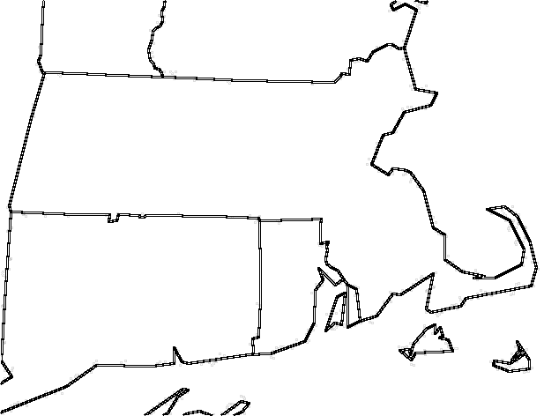
Raster Data and Cell Size
Coarser resolution
Finer resolution
Notes:
Raster Data and Cell Size
Coarse resolution raster data uses fewer cells to cover a given area than fine resolution data. When analyzing data, the finer resolution data more closely approximates the area of interest, includes more data points, and can in turn give more accurate information.

Slide 8
What is a Raster ?
Two dimensional array of regularly spaced elements (pixels or cells)
Orthophotos
Remote Sensing
Gridded data (raster GIS)
Image data is collected by a variety of technologies
Satellite remote sensing
Airborne photogrammetry
Sonar
Digital images can be composed of one or more bands
Bands often represent an interval of wavelengths along the electromagnetic spectrum
Band data can be simultaneously recorded
2
5
4
9
1
9
7
6
6
1
1
1
1
1
6
6
1
3
8
7
9
7
9
1
3
1
8
3
3
5
9
1
3
3
3
9
8
7
9
1
0
3
3
3
9
9
1
0
0
8
8
9
9
1
0
0
0
0
2
9
1
0
0
0
Notes:
Raster Data Concepts
Digital imagery is a specialized type of raster data. A digital image is a two dimensional array (a matrix or grid) of regularly spaced picture elements (pixels). Typically, digital images do not require a separate table to hold value/attribute information.
Digital imagery is created from optical or other sensor data, and is collected using a variety of technologies including satellite remote sensing, airborne photogrammetry, and sonar.
Digital images can be composed of one or more bands. Each band often represents an interval of wavelengths along the electromagnetic spectrum. Multiple bands of an image can be simultaneously recorded.

Slide 9
Cells and Bands
Cell data is the value associated with the cells/pixels
Each cell has a value in a raster
Each value is associated with a cell/pixel
In an RGB image, each cell has 3 values: one each to represent the intensity of red, green, and blue
In GeoRaster, all cells associated with a 2-D set of rows and columns in a plane is a band
An RGB image will have 3 bands
A multispectral image with 4 channels will have 4 bands in GeoRaster
Grid data with 4 bands will have 4 bands in GeoRaster
2
5
4
9
1
9
7
6
6
2
1
5
1
4
1
9
1
1
1
9
6
7
6
6
6
2
1
5
1
4
1
9
1
1
1
9
6
7
6
6
1
3
8
7
9
7
9
1
1
6
3
1
8
1
7
1
9
1
7
1
9
6
1
6
3
1
8
3
3
5
9
1
3
1
1
3
8
8
3
7
3
9
5
7
9
9
1
1
3
3
3
9
8
7
9
1
3
3
3
1
3
8
9
3
8
3
7
5
9
9
1
1
0
3
3
3
9
9
1
0
0
3
3
3
3
3
3
9
9
8
9
7
1
9
0
1
0
8
8
9
9
1
0
0
0
0
8
3
8
3
9
3
9
9
1
9
0
1
0
0
0
0
2
9
1
0
0
0
0
0
0
8
2
8
9
9
1
9
0
1
0
0
0
0
0
0
2
9
1
0
0
0
Notes:
Cell Data and Bands
In Oracle Spatial GeoRaster, band has a specific meaning.
A band is a physical dimension in a multidimensional raster data set. It is one dimension in the cell space, where data is stored in terms of rows, columns, and bands. A single GeoRaster object can have multiple bands. Band numbering in Oracle Spatial GeoRaster starts at band 0, and goes up to n-1, where n is the total number of bands in the GeoRaster object. Bands are used when physically addressing GeoRaster data in cell space.

Slide 10
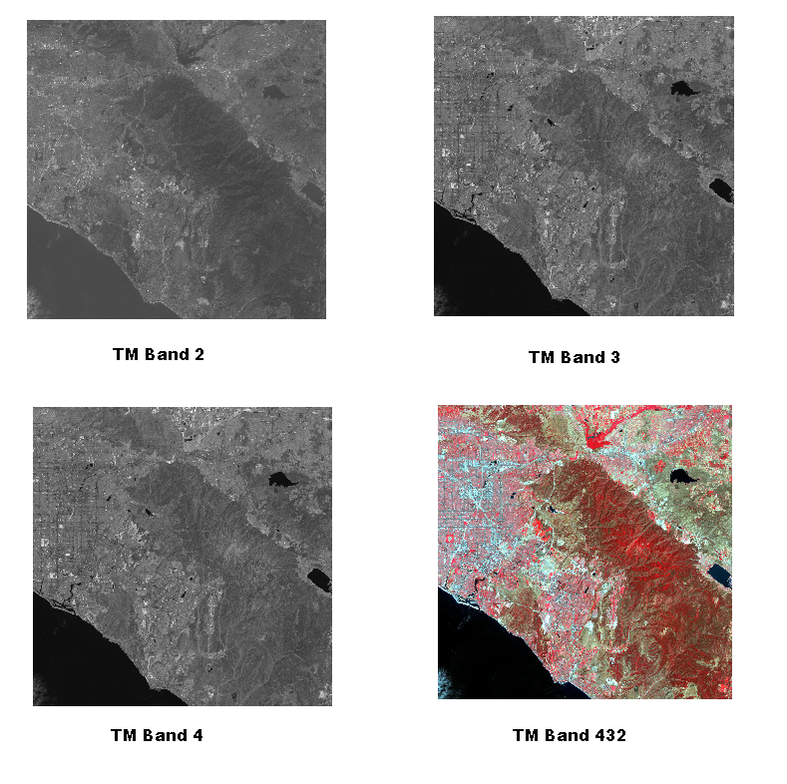
Multi band Images
Some bands accentuate different features
Notes:
Image Data
This is an example of image data with multiple bands. Some bands can accentuate different features. Each band here is an image captured at a different frequency range in the electromagnetic spectrum. The 4th image is the composition of the three bands together shown with a color map. This is an example of a false color image. The color map specifies how to map the cell values in each band to R (red, for band 4), G (green, for band 3) and B (blue, for band 2).

Slide 11
Resolution Pyramid
Pyramid
Level 2)
Gradually simplified copies of the raster
Pyramid
Level 1
Step down the pyramid when zooming in
Typically increases storage cost by 33% to 40%
Pyramid
Level 0
Notes:
Pyramids
This illustrates how pyramids reduce the resolution and the amount of raster data stored. At pyramid level 0, the data is shown at the resolution it was originally stored at, showing a matrix of 16 rows x 16 columns. At pyramid level 1, the resolution is reduced by ½ to 8 rows x 8 columns (storage required are reduced to ¼ the original storage requirements), and at pyramid level 2 the resolution and storage requirements drop again to 4 rows x 4 columns. Oracle Spatial GeoRaster allows users a choice of algorithms to use when pyramids are created.

Slide 12
Blocking
A GeoRaster image can be composed of an extremely large number of cells
It is more efficient in terms of storage and retrieval to break large images into smaller blocks
In GeoRaster, users/applications can determine how data is blocked
Specify rows, columns, and optionally bands
n x m blocks
Notes:
Blocking
A GeoRaster image can be tens of millions of bytes, or more. In order to facilitate efficient, fast storage and retrieval of large images, the images can be broken into smaller blocks, where subsets of the image are stored and are separately addressable by Oracle Spatial GeoRaster. Users and/or applications can determine how raster data is blocked in the database. In this example, the GeoRaster data in an 8 row by 8 column matrix is blocked into four 4 row by 4 column blocks.

Slide 13
Interleaving
Interleaving is used when storing multi-band images.
Oracle GeoRaster supports three methods of interleaving
Band Sequential (BSQ)
Band interleaved by line (BIL)
Band interleaved by pixel (BIP)
Each method can be optimal depending on the requirements of the application
Notes:
Interleaving
Interleaving is used when storing multi-band images.
In Oracle Spatial GeoRaster there are three methods of interleaving supported. The three methods are band interleaving (Band SeQential or BSQ), Band Interleaved by Line (or BIL), and Band Interleaved by Pixel (or BIP). Each storage method can be optimal depending of what the application requires the GeoRaster data for. For example, if the application only uses one band of data at a time, then band sequential may be the best storage mechanism. For certain image processing functions (such as fast fourier transforms) processing images by line may occur, hence the best storage method would be band interleaved by line. Similarly, if the application will overlay each pixel with pixels from other bands, then band interleaved by pixel may be the optimal way of storing the data.

Slide 14
Multiband Image Interleaving Band Sequential (BSQ)
Column 0
Row 0
0
0
0
0
1
1
1
1
2
2
2
2
0
0
0
0
1
1
1
1
2
2
2
2
0
0
0
0
1
1
1
1
2
2
2
2
0
0
0
0
1
1
1
1
2
2
2
2
Band 0
Band 1
Band 2
0
0
0
0
0
0
0
0
0
0
0
0
0
0
0
0
1
1
1
1
1
1
1
1
1
1
1
1
1
1
1
1
2
2
2
2
2
2
2
2
2
2
2
2
2
2
2
2
Notes:
Multiband Image Interleaving in GeoRaster
This example shows band sequential interleaving in GeoRaster using three bands. In band sequential interleaving, data from each band is stored completely before data from another band is stored. Band sequential interleaving is useful when GeoRaster data is operated on one band at a time.

Slide 15
Multiband Image Interleaving Band Interleaved by Line (BIL)
Column 0
Row 0
0
0
0
0
1
1
1
1
2
2
2
2
0
0
0
0
1
1
1
1
2
2
2
2
0
0
0
0
1
1
1
1
2
2
2
2
0
0
0
0
1
1
1
1
2
2
2
2
Band 0
Band 1
Band 2
0
0
0
0
1
1
1
1
2
2
2
2
0
0
0
0
1
1
1
1
2
2
2
2
0
0
0
0
1
1
1
1
2
2
2
2
0
0
0
0
1
1
1
1
2
2
2
2
Notes:
Multiband Image Interleaving in GeoRaster
This example shows band sequential interleaving in GeoRaster using three bands. In band sequential interleaving, data from each band is stored completely before data from another band is stored. Band sequential interleaving is useful when GeoRaster data is operated on one band at a time.

Slide 16
Multiband Image Interleaving Band Interleaved by Pixel (BIP)
Column 0
Row 0
0
0
0
0
1
1
1
1
2
2
2
2
0
0
0
0
1
1
1
1
2
2
2
2
0
0
0
0
1
1
1
1
2
2
2
2
0
0
0
0
1
1
1
1
2
2
2
2
Band 0
Band 1
Band 2
0
1
2
0
1
2
0
1
2
0
1
2
0
1
2
0
1
2
0
1
2
0
1
2
0
1
2
0
1
2
0
1
2
0
1
2
0
1
2
0
1
2
0
1
2
0
1
2
Notes:
Multiband Image Interleaving in GeoRaster
This example shows band sequential interleaving in GeoRaster using three bands. In band sequential interleaving, data from each band is stored completely before data from another band is stored. Band sequential interleaving is useful when GeoRaster data is operated on one band at a time.

Slide 17
Cell Depth
Specifies the size of the cells or pixels
Integers can be 8bits, 16bits or 32bits, signed or unsigned
Default for imagery is 8BIT_U
1BIT
2BIT
4BIT
8BIT_U
8BIT_S
16BIT_U
16BIT_S
32BIT_U
32BIT_S
32BIT_REAL
64BIT_REAL

Slide 18
Compression for Imagery
JPEG Compression
Lossy compression
Use for imagery
For rasters with cellDepth=8BIT_U and no more than 4 bands per block
Control the compression level using the quality parameter
0 (max compression) to 100 (no compression)
Default quality is 75
JPEG-2000 Compression
Lossy compression but compresses much better than JPEG
Use for imagery
For rasters with cellDepth=8BIT_U or 16BIT_U
Control the compression level using the ratio parameter.
A ratio of 20 means a reduction of 20:1, i.e. 5% of the input.

Slide 19
Compression for Grids
DEFLATE Compression
Lossless compression
Use for grids, terrain models, etc
Uses the ZLIB format

Slide 20
The Impact of Compression
Consider one TIFF file of 53 MB (uncompressed)
When compressed as JPEG-F it is reduced to 4.4 MB
This a compression ratio of 1:12
Add 50% to accommodate the pyramid (approx 2.1 MB)
Total storage will be approx 6.5 MB
This is now a compression ratio of 1:8

Slide 21
The Impact of Compression
Without Database Compression
Files |  |  |  |  | Database (uncompressed)
Compression | Average file size (MB) | Number of files | Total size (MB) | Total size (GB) | Base size (MB) | Pyramid Size (MB) | Total Size (MB) | Ratio with Files
Uncompressed | 52,9 | 10 000 | 529 000 | 517 | 529 000 | 211 600 | 740 600 | 1,4
Compressed | 4,4 | 10 000 | 44 083 | 43 | 529 000 | 211 600 | 740 600 | 16,8
With Database Compression
Files |  |  |  |  | Database (compressed)
Compression | Average file size (MB) | Number of files | Total size (MB) | Total size (GB) | Base size (MB) | Pyramid Size (MB) | Total Size (MB) | Ratio with Files
Uncompressed | 52,9 | 10 000 | 529 000 | 517 | 44 083 | 23 364 | 67 448 | 0,13
Compressed | 4,4 | 10 000 | 44 083 | 43 | 44 083 | 23 364 | 67 448 | 1,53

Slide 22
Value Attribute Table
A Value Attribute Table (VAT) is used to map the stored numeric values to the meaning of that value
An example value attribute table for geological raster data
CELL VALUE GEOLOGICAL PERIOD
1 Quaternary
2 Tertiary
3 Paleocene-Cretaceous
4 Mesozoic
5 Gondwana
6 Early Palaeozoic
7 Proterozoic
8 Early Proterozoic
9 Archaean
0 Blank Cell (no data)
Stored cell values
2
5
4
9
1
9
7
6
6
1
1
1
1
1
6
6
1
3
8
7
9
7
9
1
3
1
8
3
3
5
9
1
3
3
3
9
8
7
9
1
0
3
3
3
9
9
1
0
0
8
8
9
9
1
0
0
0
0
2
9
1
0
0
0
Notes:
Grid Raster Data
A Value Attribute Table ties the allowable stored values for each cell to the meaning of those stored values. In the above example, the cell values one through nine represent the various geological periods from most recent (Quaternary) to most ancient (Archaean). If no cell data was collected for certain locations, or if it doesn’t make sense to include cell data from locations, those cells can be assigned an empty cell value. Note the grid data to the right simply contains the stored the values for each cell.
A value attribute table can contain other information useful to a user and/or application.

Slide 23
Colormap Table
A COLORMAP table is used to map the stored numeric values to the display characteristics of that value
An example COLORMAP table for geological raster data
CELL VALUE Red Green Blue
1 255 255 0
2 82 123 67
3 142 230 98
4 96 121 228
5 145 231 243
6 255 51 0
7 203 188 224
8 195 135 75
9 204 102 255
0 0 0 0
2
5
4
9
1
9
7
6
6
1
1
1
1
1
6
6
1
3
8
7
9
7
9
1
3
1
8
3
3
5
9
1
3
3
3
9
8
7
9
1
0
3
3
3
9
9
1
0
0
8
8
9
9
1
0
0
0
0
2
9
1
0
0
0
Notes:
Grid Raster Data
A COLORMAP table is used to associate cell values with colors that will be used for display purposes. Above is an example of an RGB (Red Green Blue) color map for the geological data previously described. This example table shows the cell values and the colors each value will display in when rendered as a map. On the upper right there is a grid with the cell values, and on the lower right is the grid showing the display colors on a map. In this example, valid color map values are from 0 to 255. Note that color map information often includes an alpha value, associated with opacity.

Slide 24
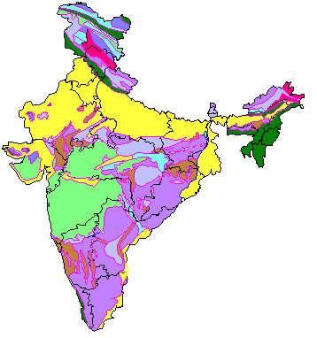
Geological Map of India
Quaternary
Tertiary
Paleocene-Cretaceous
Mesozoic
Gondwana
Early Palaeozoic
Late Proterozoic
Early Proterozoic
Archaean
Notes:
Geological Map of India (Grid Data)
This geological map of India is an example of grid data. Various geological types are encoded and displayed as different colors. The legend combines information in the Value Attribute Table (VAT) and the colormap table to help users understand the meaning of the map.

Slide 25
Georeferencing
Georeferencing establishes the relationship between cell coordinates of GeoRaster data and real-world ground coordinates or other local coordinates
Georectification is the process of assigning ground control points (GCPs) to digital images and processing the image to better map it to the surface of the Earth
In this release, GeoRaster only supports affine transformations that georeference two dimensional raster data
The implementation in GeoRaster is known as the GeoRaster Spatial Reference System
Notes:
Georeferencing
Georeferencing allows raster data to be mapped from its row/column grid structure to a location on the surface of the Earth, or some location based on a local coordinate system.
Georectification is the process of assigning ground control points (GCPs) to digital images and using various image processing techniques allows the image to be closely mapped to the surface of the Earth. Georeferencing allows each cell in the image to be mapped to its location on the surface of the Earth, or, given a location on the surface of the Earth, the cell that represents that location can be found.
In Oracle Spatial GeoRaster, georeferencing is done using the GeoRaster Spatial Reference System. This system uses affine transformations to allow two dimensional raster cells to be mapped to specific locations, and it allows the appropriate raster cell (or cells) to be found given a specific location.

Slide 26
Georeferencing
Raster Data
Cell Coordinate System
Geographic Entities
Model (ground) space
Model (ground) coordinate system
column
row
National
Park
GeoRaster Spatial Reference System (SRS)
Restaurant
Y
X
Notes:
Georeferencing
In the objects on the left, the medium-size rectangle represents a raster image, and within it are a rectangular area showing a national park and a point identifying the location of a specific restaurant. Each pixel in the image can be identified by its coordinates in a cell coordinate system (the coordinate system associated with the raster image).
In the objects on the right, the large rectangle represents the geographical area (in the model, or ground, space) that is shown in the raster image, and within it are spatial geometries for the national park and the specific restaurant. Each entire geographical area and geometries within it can be identified using coordinates in its model (or, ground) coordinate system, such as WGS 84 for longitude/latitude data.
In order to go from the cell coordinate system to the ground coordinate system, GeoRaster currently supports affine transformation that georeferences only two-dimensional images.

Slide 27
<Insert Picture Here>
Storage Model

Slide 28
Enabling GeoRaster
12.1.0.2: Georaster is not enabled by default !
Remember to enable it:
For multi-tenant environments: do this in each PDB!
SQL> DESCRIBE SDO_GEORASTER
ERROR:
ORA-04043: object sdo_georaster does not exist
SQL> EXECUTE MDSYS.enableGeoRaster;

Slide 29
Storage Model
Separates logical from physical structures
Logical structures
Tables containing an SDO_GEORASTER column
Contains raster metadata and footprint
Also contains a pointers to an RDT
Physical structures
“Raster data tables” or RDTs
Contain raster blocks
Can be very large
Structure defined in SDO_RASTER type

Slide 30
Storage Model Separates Logical from Physical structures
Logical structures
Contains raster metadata and footprint
Also contains a pointers to one or more RDT’s
Physical structures
“Raster data tables” or RDTs
Contain raster pixels
Can be very large
raster 11
raster 11 blocks
raster 12
raster 12 blocks
raster 13
raster 13 blocks
raster 14
raster 14 blocks
raster 15
raster 15 blocks
raster 16
raster 16 blocks

Slide 31
Storage Model
raster data table 1
raster table
raster 11 blocks
raster 11
raster 12 blocks
raster 13 blocks
raster 12
raster 13
raster 14
raster data table 2
raster 15
raster 14 blocks
raster 16
raster 15 blocks
raster 16 blocks

Slide 32
Storage Model
raster table 1
raster 11
raster data table
raster 12
raster 11 blocks
raster 13
raster 12 blocks
raster 13 blocks
raster table 2
raster 14 blocks
raster 15 blocks
raster 14
raster 16 blocks
raster 15
raster 16

Slide 33
Storage Model A more complex example: not recommended!
raster table 1
raster data table 1
raster 11
raster 11 blocks
raster 12
raster 21 blocks
raster 13
raster 22 blocks
raster 14
raster data table 2
raster 13 blocks
raster table 2
raster 24 blocks
raster 21
raster data table 3
raster 22
raster 12 blocks
raster 23
raster 14 blocks
raster 24
raster 23 blocks

Slide 34
A Look Inside Raster Blocks
Binary integers (16 bit, 32 bit) are stored in big-endian encoding
Floating points (32 bit and 64 bit) are in IEEE 754 encoding
Small binary integers (1 bit, 2 bit, 4 bit) fill bytes: a byte will therefore contain 8x1-bit cells, or 4x2-bit cells, or 2x4-bit cells.
Bytes are filled from “left” to “right”, i.e. from high-order bits to low-order bits

Slide 35
<Insert Picture Here>
Loading Rasters

Slide 36
Installing the Georaster tools (load, view, import)
Use jar file georaster_tools.jar
Found in $ORACLE_HOME/md/demo/georaster/java/
Installed only with the “examples” CD

Slide 37
Loading Rasters: Flow of Operation
Create the raster table(s)
Create the raster data table(s)
Initialize the raster
Load into the database (the "push" method)
Load from the database (the "pull" method)
Georeferencing
Set Georeferencing Parameters
Set Model SRID
Generate Spatial Extent
Generate resolution pyramid
Create spatial index

Slide 38
Creating Raster Tables
CREATE TABLE US_RASTERS(
GEORID NUMBER PRIMARY KEY,
SOURCE_FILE VARCHAR2(80),
DESCRIPTION VARCHAR2(32),
GEORASTER SDO_GEORASTER
);
Use the SDO_GEORASTER type
Combine with any other attributes
RASTERTYPE NUMBER
SPATIALEXTENT SDO_GEOMETRY
RASTERDATATABLE VARCHAR2(32)
RASTERID NUMBER
METADATA SYS.XMLTYPE

Slide 39
Creating Raster Data Tables
Use the SDO_RASTER type
Control the storage of LOBs (use SECUREFILE lobs)
CREATE TABLE RDT_01 OF SDO_RASTER (
PRIMARY KEY (
RASTERID, PYRAMIDLEVEL, BANDBLOCKNUMBER,
ROWBLOCKNUMBER, COLUMNBLOCKNUMBER
)
)
LOB(RASTERBLOCK) STORE AS SECUREFILE (
STORAGE (INITIAL 1024G)
NOCACHE NOLOGGING
);
RASTERID NUMBER
PYRAMIDLEVEL NUMBER
BANDBLOCKNUMBER NUMBER
ROWBLOCKNUMBER NUMBER
COLUMNBLOCKNUMBER NUMBER
BLOCKMBR SDO_GEOMETRY
RASTERBLOCK BLOB
RDTs must have unique names (across schemas)
RDTs not listed in USER_TABLES but in USER_OBJECT_TABLES

Slide 40
After all loading is done …
Re-enable caching and logging on the RDTs
ALTER TABLE RDT_01
MODIFY LOB(RASTERBLOCK)
(
CACHE
LOGGING
);

Slide 41
Initializing Rasters
This is generally done by the loading tool
Specify the storage location for the blocks
Name of raster data table
Will be created if it does not exist!
Unique id in that table
If no id provided, one will be assigned automatically
INSERT INTO US_RASTERS (GEORID, GEORASTER)
VALUES (1, SDO_GEOR.INIT('RDT_01',1));
INSERT INTO US_RASTERS (GEORID, GEORASTER)
VALUES (2, SDO_GEOR.INIT('RDT_01',2));
INSERT INTO US_RASTERS (GEORID, GEORASTER)
VALUES (3, SDO_GEOR.INIT('RDT_02',3));
INSERT INTO US_RASTERS (GEORID, GEORASTER)
VALUES (4, SDO_GEOR.INIT('RDT_02',4));
Raster data table
Raster id

Slide 42
Loading Rasters
Oracle tools
Java command line
Raster viewer/importer/exporter
Mapbuilder
Java API
Open Source
GDAL
Commercial tools
FME
Database-Driven
Use PL/SQL
SDO_GEOR.ImportFrom()
Georaster ETL
Choose files to load
Set parameters
Uses GDAL for the actual loading
Parallel loading

Slide 43
Using the Java command line
java -Xms900M -Xmx900M GeoRasterLoader
127.0.0.1 orcl111 1521
scott tiger
thin 32 T
us_rasters georaster
"blocking=true,blocksize=(512,512,3), spatialExtent=true,compression=jpeg-f"
"sf1.tif,1,RDT_01,sf1.tfw,26943"
JDBC connection parameters
Table and column
Load parameters
Source file and TFW
Raster id and data table
Projection

Slide 44
Importing GeoTIFFS
Need additional libraries in your class path
xtiff-jai.jar
Available from the SourceForge Extensible-TIFF-JAI group
geotiff-jai.jar
Available from the SourceForge GeoTIFF-JAI group
Specify that your input files are geotiff
No need to specify any TFW files
Specify an explicit SRID – needed if we cannot recognize the projection from the file
"blocking=true,blockSize=(300,200),spatialExtent=true,geotiff=true" "srtm_12_05.tif,1,us_srtm_rdt_01"
"blocking=true,blockSize=(300,200),spatialExtent=true,geotiff=true, srid=8307"

Slide 45
Importing JPEG2000 Images
Add the following library to your class path
jai-imageio.jar
Available from the Sun Java Advanced Imaging Image I/O Tools download page

Slide 46
Character Set!
If your database uses a character set other than US7ASCII, WE8MSWIN1252, WE8ISO8859P1 or UTF8
Include $ORACLE_HOME/jlib/orai18n.jar in your classpath!
java.sql.SQLException: Non supported character set (add orai18n.jar in your classpath): oracle-character-set-179

Slide 47
Database-driven Import
declare
g sdo_georaster;
begin
select georaster into g from us_rasters
where georid = 1 for update;
sdo_geor.importFrom(
g,
'blocksize=(512,512)',
'TIFF', 'file', '/usr/rasters/sf1.tif',
'WORLDFILE', 'file', '/usr/rasters/sf1.tfw',
);
update us_rasters
set georaster = g
where georid = 1;
end;
Read Raster
For update
Import from file
Specify blocking and compression
Update Raster
Notes:
Writing queries is straightforward - at least for anyone having a basic understanding of the SQL language. All the developers will need to learn is a new predicate (SDO_RELATE)
Of course, users of «GIS» graphical tools do not need to worry about SQL: the tools will generate the SQL queries automatically, based on the graphical selections and operations performed.

Slide 48
Database-driven Import and GeoTIFFs
Must first load the geotiff libraries in your database:
Specify that your input files are GeoTiff.
loadjava -user mdsys/mdsys@orcl111 -resolve -force -synonym -schema MDSYS -grant PUBLIC -verbose xtiff-jai.jar
loadjava -user mdsys/mdsys@orcl111 -resolve -force -synonym -schema MDSYS -grant PUBLIC -verbose geotiff-jai.jar
sdo_geor.importFrom(
g,
'blocksize=(300,200,1)',
'GEOTIFF', 'file', '/usr/rasters/srtm_12_05.tif',
);

Slide 49
Database-driven Import and JPEG2000
Must first load the proper library in your database:
loadjava -user mdsys/mdsys@orcl111 -resolve -force -synonym -schema MDSYS -grant PUBLIC -verbose jai-imageio.jar

Slide 50
Database-driven Import Grant file access
Prior to load: must grant access to the files to load to the loading user
Grant access to individual files:
Grant access to all files in a directory :
Grant access to all files on the server :
Must also grant access to MDSYS :
SQL> call dbms_java.grant_permission('SCOTT',
'java.io.FilePermission', '/usr/data/rasters/sf1.tif','read');
SQL> call dbms_java.grant_permission('SCOTT',
'java.io.FilePermission', '/usr/data/rasters/sf1.tfw','read');
SQL> call dbms_java.grant_permission('SCOTT',
'java.io.FilePermission', '/usr/data/rasters/*','read');
SQL> call dbms_java.grant_permission('SCOTT',
'java.io.FilePermission', ‘<<ALL FILES>>','read');
SQL> call dbms_java.grant_permission('MDSYS',
'java.io.FilePermission', ‘<<ALL FILES>>','read');

Slide 51
Database-driven Import Handling Loading Errors
The input image files are processed using the JAI classes (Java Advanced Imaging)
The load may fail with the following error:
This indicates an exception while reading the input file
Typically indicates a malformed file or a format not supported by JAI
ERROR at line 1:
ORA-13464: error loading GeoRaster data: - Unable to render RenderedOp for this operation.
ORA-06512: at "MDSYS.MD", line 1723
ORA-06512: at "MDSYS.MDERR", line 17
ORA-06512: at "MDSYS.SDO_GEOR", line 5006
ORA-06512: at line 34

Slide 52
Database-driven Import How to see the full Java exception
You can see the full Java exception leading to the error by doing:
Example result:
SQL> set serveroutput on SQL> exec dbms_java.set_output(1000000)
Error: IOException occurs when decode the image.
Occurs in: com.sun.media.jai.opimage.StreamRIF
java.io.IOException: Planar (band-sequential) format TIFF is not supported.
at com.sun.media.jai.codecimpl.CodecUtils.toIOException(CodecUtils.java:76)
at com.sun.media.jai.codecimpl.TIFFImageDecoder.decodeAsRenderedImage(TIFFImageDecoder.java:109)
…
at oracle.spatial.georaster.GeoRasterAdapter.loadFromFile(GeoRasterAdapter.java:1228)

Slide 53
Database-driven Import Controlling the heap size of the database JVM
The default heap size used by the JVM may be insufficient to load large images
To manage the heap, first create the following two functions.
To view the current heap size:
To set the heap size:
CREATE OR REPLACE FUNCTION get_max_memory_size RETURN NUMBER AS
LANGUAGE JAVA
NAME 'oracle.aurora.vm.OracleRuntime.getMaxMemorySize() returns long';
/
CREATE OR REPLACE PROCEDURE set_max_memory_size (bytes NUMBER) AS
LANGUAGE JAVA
NAME 'oracle.aurora.vm.OracleRuntime.setMaxMemorySize(long)';
/

Slide 54
Database-driven Import Controlling the heap size of the database JVM
Check the default heap size :
Raise it to 512 MB :
SQL> select get_max_memory_size/1024/1024 mb from dual;
MB
----------
256
1 row selected.
SQL> exec set_max_memory_size(512*1024*1024);
PL/SQL procedure successfully completed.
SQL> select get_max_memory_size/1024/1024 mb from dual;
MB
----------
512
1 row selected.

Slide 55
<Insert Picture Here>
Using GDAL

Slide 56
Using GDAL
Open source library and tools. Supports many formats
Available from http://www.gdal.org/
Version 1.9 included with Oracle 12c Release 1 and later in $ORACLE_HOME/md/demo/georaster/etl
gdal19-linux64.zip
gdal19-win32.zip
gdal19-win64.zip
Also available online inside file GeoRasterETL.zip from
http://www.oracle.com/technetwork/indexes/samplecode/spatial-1433316.html
Use the proper version for your platform

Slide 57
Using GDAL
You can also download Windows pre-built binaries from http://trac.osgeo.org/osgeo4w/
Packaging of a number of open source tools for Windows (GDAL/OGR, GRASS, MapServer, OpenEV, uDig, QGIS, …)
Download an installer and select the packages to install
Other source: http://www.gisinternals.com/sdk/
Daily builds of stable and development versions for multiple windows variants (includes WIN64).
Includes windows installers

Slide 58

Using GDAL
To setup
Unzip the archive
Add <…>/gdal<xxxx>/bin to your path and <…>/gdal<xxxx>/lib to your library path
Set GDAL_DATA to <…>/gdal<xxxx>/data (optional)
Main commands for vector data
gdalinfo = get information about a file (or spatial table)
gdal_translate = copy from one format to another (import/export)
Documentation
http://www.gdal.org
http://www.gdal.org/formats_list.html
http://www.gdal.org/frmt_georaster.html
Book:
http://www.amazon.com/gp/product/0989421716

Slide 59
GDAL supported Formats
D:\> gdalinfo --formats
See complete list here: http://www.gdal.org/formats_list.html
Some formats are “built-in”, some use plugins
Find details about one format:
Useful to find out the syntax of parameters specific to this format
AAIGrid (rw): Arc/Info ASCII Grid
AIG (ro): Arc/Info Binary Grid
...
EIR (ro): Erdas Imagine Raw
ELAS (rw+): ELAS
ERS (rw+): ERMapper .ers Labelled
ESAT (ro): Envisat Image Format
...
GTiff (rw+): GeoTIFF
GXF (ro): GeoSoft Grid Exchange Format
...
GeoRaster (rw+): Oracle Spatial GeoRaster
...
HFA (rw+): Erdas Imagine Images (.img)
...
JPEG (rw): JPEG JFIF
...
VRT (rw+): Virtual Raster
XPM (rw): X11 PixMap Format
D:\> gdalinfo --format georaster
Oracle Georaster plugin is installed

Slide 60
Main GDAL Utilities
gdal_translate
Main tool to convert a raster from one format to another (like TIFF to JPEG)
Will be used to load rasters into Oracle as well as to export from Oracle
Can be used to change the structure of a raster from BSQ to BIP (so that the JAI classes can read it)
Can also be used to extract the georeferencing information from a GeoTIFF raster into a TFW file
Many other conversions are possible, such a breaking a very large file into a set of smaller files or fusing many into a single large raster (mosaicing)

Slide 61
Other GDAL Utilities
gdalinfo
Prints out information about a raster
Useful to find out any georeferencing and projection information as well as the structure of a raster
gdaladdo
Adds overviews to a raster, i.e. generate a resolution pyramid
gdalwarp
Reprojects a raster to a different coordinate system
Many more available. See: http://www.gdal.org/gdal_utilities.html
Supported formats: see: http://www.gdal.org/formats_list.html
Oracle Georaster: see: http://www.gdal.org/frmt_georaster.html

Slide 62
Importing a raster from a file
Source
gdal_translate -of georaster sf1.tif
georaster:scott/tiger@orcl112,us_rasters,georaster
-co blockxsize=512 -co blockysize=512 -co blockbsize=3
-co interleave=bip -co srid=26943
-co "insert=(georid, source_file, georaster) values (1, 'sf1.tif',
sdo_geor.init('us_rasters_rdt_01'))"
Destination
-of georaster | Use Oracle Georaster as output
sf1.tif | Name of input TIFF file
georaster:scott/tiger@orcl112 | Database connection
us_rasters,georaster | Destination table and column
-co block%size | Block size in x, y and b (band)
-co SRID=26943 | Coordinate system of the raster
-co interleave | Interleaving (default is band sequential)
-co insert | The parameters of an insert statement to insert a row in the raster table
-co genpyramid=nn | Generate the resolution pyramid after the load has completed

Slide 63
Using Optimal Block Size
Blocks may include padding
For example: raster is 4299x4299
Blocksize 512x512 is not optimal – produces padding and wasted space
This uses a block size of 430x430 – no or little padding
gdal_translate -of georaster sf1.tif
georaster:scott/tiger@orcl111,us_rasters,georaster
-co blocking=optimalpadding
-co blockxsize=512 -co blockysize=512 -co blockbsize=3
-co interleave=bip -co srid=26943
-co "insert=values (1, 'sf1.tif', 'Aerial photo San Francisco 1',
sdo_geor.init('us_rasters_rdt_01', 1),null,null)"

Slide 64
Compress while Loading
Much more efficient than loading, then compressing later
gdal_translate -of georaster sf1.tif
georaster:scott/tiger@orcl111,us_rasters,georaster
-co blockxsize=512 -co blockysize=512 -co blockbsize=3
-co interleave=bip -co srid=26943
-co compress=jpeg-f
-co "insert=values (1, 'sf1.tif', 'Aerial photo San Francisco 1',
sdo_geor.init('us_rasters_rdt_01', 1),null,null)"

Slide 65
Mosaic while Loading
Load a set of raster files into a single georaster object
More efficient than loading, then mosaicing later
First, define a “virtual data set” (VRT)
Lists all the tif files to combine
Then load the “virtual data set”
gdalbuildvrt sf.vrt *.tif
gdal_translate -of georaster sf.vrt
georaster:scott/tiger@orcl111,us_rasters,georaster
-co blockxsize=512 -co blockysize=512 -co blockbsize=3
-co interleave=bip -co srid=26943
-co "insert=values (1, 'sf.tif', 'Aerial photo San Francisco',
sdo_geor.init('us_rasters_rdt_01’),null,null)"

Slide 66
Reproject while Loading
Use gdalwarp instead of gdal_translate
-t_srs specifies the coordinate system to reproject to
-a_srs specifies the coordinate system of the input file
Needed only if it cannot be determined from the geotiff tags in the input file
gdalwarp -of georaster sf1.tif
georaster:scott/tiger@orcl111,us_rasters,georaster
-co blockxsize=512 -co blockysize=512 -co blockbsize=3
-co interleave=bip
-overwrite
-t_srs EPSG:4326
-co "insert=values (1, 'sf1.tif', 'Aerial photo San Francisco 1',
sdo_geor.init('us_rasters_rdt_01', 1),null,null)"

Slide 67
Reproject, Compress and Mosaic while Loading
Define the “virtual data set” (VRT)
Lists all the tif files to combine
Then process the “virtual data set”
gdalbuildvrt sf.vrt *.tif
gdalwarp -of georaster sf.vrt
georaster:scott/tiger@orcl111,us_rasters,georaster
-co blockxsize=512 -co blockysize=512 -co blockbsize=3
-co interleave=bip
-co compress=jpeg-f
-overwrite
-t_srs EPSG:4326
-co "insert=values (1, 'sf.tif', 'Aerial photo San Francisco',
sdo_geor.init('us_rasters_rdt_01’),null,null)"

Slide 68
Compress as JPEG2000
No need to specify block sizes
Loading automatically generates the pyramid
Specify the compression level using the JP2_QUALITY parameter
represents the percentage in size reduction
for example: 5 means that the raster is reduced to 5% of the input file
this is a compression ratio of 100/5 = 20:1
Default quality is 25 (= ratio 4:1)
gdal_translate -of georaster sf1.tif
georaster:scott/tiger@orcl111,us_rasters,georaster
-co compress=jp2-f
-co "insert=values (1, 'sf1.tif', 'Aerial photo San Francisco 1',
sdo_geor.init('us_rasters_rdt_01', 1),null,null)"

Slide 69
Compress as JPEG2000
GDAL build must contain a JPEG2000-capable plugin
JP2OpenJPEG (Open source) or JP2ECW (ERDAS SDK)
Load fails if none present
Plugin must allow compression.
Specifying JP2_QUALITY=100 gives a lossless compression
Still smaller than the original file
ERROR 1: Unable to copy JPEG2000 image into GeoRaster dataset.
No JPEG2000 capable driver (JP2OPENJPEG, JP2ECW, JP2MRSID, etc...) is available."
ERROR 1: Unable to copy JPEG2000 image into GeoRaster dataset.
One or several JPEG2000 capable drivers are available but the file could not be opened successfully.

Slide 70
Loading JPEG2000 raster files
The process copies the original JP2 as-is
Includes the existing pyramid
Very fast
Do not specify any quality (the quality of the input is retained)
gdal_translate -of georaster sf1.jp2
georaster:scott/tiger@orcl111,us_rasters,georaster
-co compress=jp2-f
-co "insert=values (1, 'sf1.tif', 'Aerial photo San Francisco 1',
sdo_geor.init('us_rasters_rdt_01', 1),null,null)"

Slide 71
Reading ECW rasters
Requires the ECW GDAL plugin
Provided with our build, but not enabled
To enable, unzip the plugin file
Requires the Erdas ECW SDK
Download from Erdas’ download site
Install and configure
$ gdalinfo --formats | grep ECW
ECW -raster- (rw+): ERDAS Compressed Wavelets (SDK 5.0)
JP2ECW -raster,vector- (rw+v): ERDAS JPEG2000 (SDK 5.0)

Slide 72
Enable ECW GDAL Plugin
$ cd $GDAL_HOME/lib/gdalplugins
$ ls -l *ECW*
-rw-rw-r--. 1 spatial spatial 58935 Nov 12 2015 gdal_ECW_JP2ECW.zip
$ unzip gdal_ECW_JP2ECW.zip
Archive: gdal_ECW_JP2ECW.zip
inflating: gdal_ECW_JP2ECW.so
$ ls -l *ECW*
-rwxrwxr-x. 1 spatial spatial 152352 Nov 12 2015 gdal_ECW_JP2ECW.so
-rw-rw-r--. 1 spatial spatial 58935 Nov 12 2015 gdal_ECW_JP2ECW.zip

Slide 73
Download ERDAS ECW SDK
http://download.hexagongeospatial.com
Select product: “ERDAS ECW/JPEG2000 SDK”
Select the version for your platform
Windows, MacOS, Linux
“Download now”
Register, then download starts (around 200 MB)
Or just grab directly:
$ wget http://go.hexagongeospatial.com/ECWJP2SDK5.3.0LINUX

Slide 74
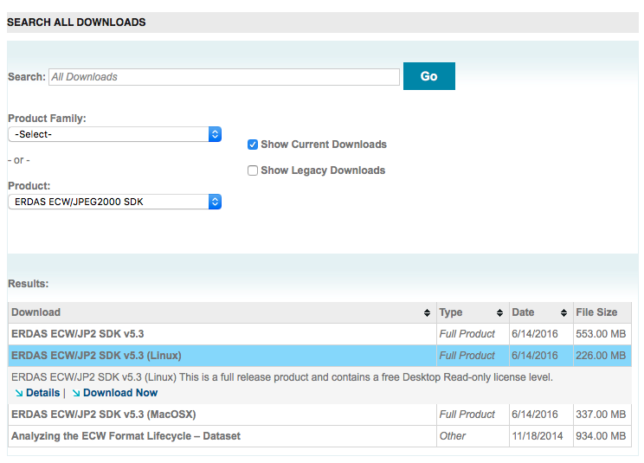
Download ERDAS ECW SDK

Slide 75
Install ERDAS ECW SDK
Unzip the SDK
Make it executable
Run the installer
Result goes to
$ unzip erdas-ecw-sdk-5.3.0-linux.zip
Archive: erdas-ecw-sdk-5.3.0-linux.zip
inflating: ERDAS_ECWJP2_SDK-5.3.0.bin
$ chmod +x ERDAS_ECWJP2_SDK-5.3.0.bin
$ ./ERDAS_ECWJP2_SDK-5.3.0.bin
$HOME/hexagon/ERDAS-ECW_JPEG_2000_SDK-5.3.0/Desktop_Read-Only

Slide 76
Install ERDAS ECW SDK
ERDAS ECW JPEG2000 SDK 5.3.0 Install
************************************
Please select the appropriate license type to deploy ...
No License Fee Required
********************************
Enter 1 for "Desktop Read-Only Redistributable"
Enter 2 for "Mobile Read-Only (Local decoding restriction apply)”
Paid Licensees
********************************
Enter 3 for "Desktop Read-Write Redistributable"
Enter 4 for "Server Read-Only End User"
Enter 5 for "Server Read-Only Redistributable"
Enter 6 for "Server Read-Write Redistributable”
[1, 2, 3, 4, 5, or 6]
1
Displaying End User License Agreement ...
ERDAS ECW/JP2 Desktop Read-Only Redistributable SDK License Agreement
...
Do you accept this License Agreement? [yes/no]
yes
Unpacking the ERDAS ECW JPEG2000 SDK 5.3.0 package to /home/spatial/hexagon/ERDAS-ECW_JPEG_2000_SDK-5.3.0/Desktop_Read-Only
Please wait …
Done.

Slide 77
Install ERDAS ECW SDK
Result goes to :
The shared libraries are in lib/x64/release :
Add to path
$HOME/hexagon/ERDAS-ECW_JPEG_2000_SDK-5.3.0/Desktop_Read-Only
$ cd $HOME/hexagon/ERDAS-ECW_JPEG_2000_SDK-5.3.0/Desktop_Read-Only
$ ls /lib/x64/release
libNCSEcw.a libNCSEcw.so libNCSEcw.so.5.3.0
libNCSEcwJNI.so.5.3.0 libNCSEcw.so.5 libNCSEcw.so.debug
libNCSEcwJNI.so.debug libNCSEcw.so.5.3
$HOME/hexagon/ERDAS-ECW_JPEG_2000_SDK-5.3.0/Desktop_Read-Only

Slide 78
Get information about a raster file
gdalinfo sf1.tif
Driver: GTiff/GeoTIFF
Files: ..\..\..\..\data\11-georaster\tiff\sf1.tif
..\..\..\..\data\11-georaster\tiff\sf1.tfw
Size is 4299, 4299
Coordinate System is:
LOCAL_CS["NAD83 / California zone 3", …]
Origin = (1828467.919737499900000,646446.278891499970000)
Pixel Size = (0.304800999999999,-0.304800999999999)
Metadata:
AREA_OR_POINT=Area
Image Structure Metadata:
INTERLEAVE=PIXEL
Corner Coordinates:
Upper Left ( 1828467.920, 646446.279)
Lower Left ( 1828467.920, 645135.939)
Upper Right ( 1829778.259, 646446.279)
Lower Right ( 1829778.259, 645135.939)
Center ( 1829123.089, 645791.109)
Band 1 Block=4299x1 Type=Byte, ColorInterp=Red
Band 2 Block=4299x1 Type=Byte, ColorInterp=Green
Band 3 Block=4299x1 Type=Byte, ColorInterp=Blue

Slide 79
Get information about all rasters in a table
gdalinfo georaster:scott/tiger,,us_rasters,georaster
Driver: GeoRaster/Oracle Spatial GeoRaster
Files: none associated
Size is 512, 512
Coordinate System is `'
Subdatasets:
SUBDATASET_1_NAME=geor:scott/tiger@,US_RASTERS_RDT_01,115
SUBDATASET_1_DESC=[4299x4299x3] CellDepth=8BIT_U SRID=26943
SUBDATASET_2_NAME=geor:scott/tiger@,US_RASTERS_RDT_01,116
SUBDATASET_2_DESC=[4299x4299x3] CellDepth=8BIT_U SRID=26943
SUBDATASET_3_NAME=geor:scott/tiger@,US_RASTERS_RDT_01,117
SUBDATASET_3_DESC=[4299x4299x3] CellDepth=8BIT_U SRID=26943
SUBDATASET_4_NAME=geor:scott/tiger@,US_RASTERS_RDT_01,118
SUBDATASET_4_DESC=[4299x4299x3] CellDepth=8BIT_U SRID=26943
Corner Coordinates:
Upper Left ( 0.0, 0.0)
Lower Left ( 0.0, 512.0)
Upper Right ( 512.0, 0.0)
Lower Right ( 512.0, 512.0)
Center ( 256.0, 256.0)

Slide 80
Get information about a database raster
gdalinfo georaster:scott/tiger@orcl111,us_rasters,georaster,georid=1
gdalinfo georaster:scott/tiger@orcl111,us_rasters_rdt_01,1
Driver: GeoRaster/Oracle Spatial GeoRaster
Files: none associated
Size is 4299, 4299
Coordinate System is:
PROJCS["NAD83 / California zone 3", …]
Origin = (1828467.919737499900000,646446.278891499970000)
Pixel Size = (0.304800999999999,-0.304800999999999)
Image Structure Metadata:
INTERLEAVE=PIXEL
COMPRESSION=NONE
Corner Coordinates:
Upper Left ( 1828467.920, 646446.279)
Lower Left ( 1828467.920, 645135.939)
Upper Right ( 1829778.259, 646446.279)
Lower Right ( 1829778.259, 645135.939)
Center ( 1829123.089, 645791.109)
Band 1 Block=512x512 Type=Byte, ColorInterp=Red
Overviews: 2149x2149, 1074x1074, 537x537, 268x268, 134x134
Band 2 Block=512x512 Type=Byte, ColorInterp=Green
Overviews: 2149x2149, 1074x1074, 537x537, 268x268, 134x134
Band 3 Block=512x512 Type=Byte, ColorInterp=Blue
Overviews: 2149x2149, 1074x1074, 537x537, 268x268, 134x134

Slide 81
Other Possibilities
Convert a raster file from BSQ to BIP
Reproject a raster file
Get details about a file
Compress a file
Change format
C:\>gdal_translate -of GTiff -co "INTERLEAVE=PIXEL" sf1.bsq.tif sf1.tif
C:\>gdalwarp -s_srs epsg:26943 -t_srs epsg:32610 sf1.tif sf1_utm.tif
C:\>gdalinfo sf1.tif
C:\>gdal_translate -of gtiff sf1.tif sf1.cmp.tif -co compress=jpeg
C:\>gdal_translate -of jpeg sf1.tif sf1.jpg

Slide 82
Debugging Problems
Get a trace of everything GDAL does
For Oracle, will list all SQL calls
Can write the trace to a file
gdal_translate -of georaster sf1.tif
georaster:scott/tiger@orcl111,us_rasters,georaster
-co blockxsize=512 -co blockysize=512 -co blockbsize=3
-co interleave=bip -co srid=26943
-co "insert=values (1, 'sf1.tif', 'Aerial photo San Francisco 1',
sdo_geor.init('us_rasters_rdt_01', 1),null,null)"
--debug on
--debug on 2>gdal_trace.log

Slide 83
GeoReferencing
Set the georeferencing parameters
Usually set when loading: extracted from the GeoTIFF tags or from the TFW file a
Set the coordinate system of the raster
Usually set when loading: extracted from the GeoTIFF tags
Or specified as parameter when loading
Compute the spatial extent of the raster
Usually computed when loading

Slide 84
GeoReferencing Set SRID and Spatial Extent
declare
geor sdo_georaster;
begin
select georaster into geor from us_rasters
where georid = 1 for update;
sdo_geor.setModelSRID(geor, 40978);
geor.spatialExtent :=
sdo_geor.generateSpatialExtent(geor);
update us_rasters
set georaster = geor
where georid = 1;
end;
Read Raster
for update
Set the SRID
Set the spatial footprint
Update Raster

Slide 85
GeoReferencing A Look at the TFW file
0.3048010000
0.0000000000
0.0000000000
-0.3048010000
1828468.0721379998
646446.1264909999
A: X pixel resolution
D: Y rotation
B: X rotation
E: Y pixel resolution
C: X upper left location
F: Y upper left location
See http://en.wikipedia.org/wiki/World_file for details
A,B,C,D,E and F are parameters for an affine transformation
Pass them to the SDO_GEOR.GEOREFERENCE() function.

Slide 86
GeoReferencing Set georeferencing parameters
declare
geor sdo_georaster;
begin
select georaster into geor from us_rasters
where georid = 1 for update;
sdo_geor.geoReference (
georaster => geor,
srid => 40978,
modelCoordinateLocation => 0,
xCoefficients => sdo_number_array(
0.3048010000, -- A = x pixel resolution
0.0000000000, -- B = y rotation
1828468.0721379998 -- C = x upper left
),
yCoefficients => sdo_number_array(
0.0000000000, -- D = x rotation
-0.3048010000, -- E = y pixel resolution
646446.1264909999 -- F = y upper left
)
);
update us_rasters
set georaster = geor
where georid = 1;
end;
Read Raster
for update
Set the georeferencing parameters
Update Raster

Slide 87
GeoReferencing Update from TFW file using GeoRasterLoader
java GeoRasterLoader
127.0.0.1 orcl111 1521
scott tiger
thin 32 T
us_rasters georaster
"spatialExtent=true"
",1,RDT_01,sf1.tfw,26943"
JDBC connection parameters
Table and column
Parameters
Raster id and data table
Projection
Specify TFW file only (no source image)

Slide 88
Generating a resolution pyramid
declare
geor sdo_georaster;
begin
select georaster into geor from us_rasters
where georid = 1 for update;
sdo_geor.generatePyramid(geor, 'rlevel=4');
update us_rasters
set georaster = geor
where georid = 1;
end;
Read Raster
for update
Generate 4-level
pyramid
Update Raster
Several algorithms available for generating the pyramid

Slide 89
Pyramiding parameters
Resampling Modes
NN: Value of the nearest neighbor cell (used by default)
BILINEAR: Distance-weighted average of the 4 nearest cells
AVERAGE4: Simple average of the 4 nearest cells
AVERAGE16: Simple average of the 16 nearest cells
CUBIC: Cubic convolution of the 16 nearest cells
Number of levels
If not specified, pyramid levels are generated until the smaller of the number of rows or columns is between 64 and 128.

Slide 90
Creating a Spatial Index
A spatial index is needed on the raster footprints
Allows mapping tools to select the rasters to render for a map request.
insert into user_sdo_geom_metadata values (
'US_RASTERS',
'GEORASTER.SPATIALEXTENT',
sdo_dim_array(
sdo_dim_element('Easting', 1000000, 2000000, 1),
sdo_dim_element('Northing', 500000, 800000, 1)
),
40978);
create index us_rasters_sx
on us_rasters (georaster.spatialextent)
indextype is mdsys.spatial_index;

Slide 91
<Insert Picture Here>
Georaster ETL

Slide 92

GeoRaster ETL
12c Release 1
Simplify the process of loading large number of rasters
Graphical user interface to select files to load and choose loading options
Block size, compression, pyramiding, …
Configures the load process in an XML description file
Uses GDAL to perform the actual loading
Includes an Oracle-built distribution of GDAL for popular platforms
Windows 32 and 64-bit, Linux 64-bit
Loads from all GDAL supported file formats
Drives the loading in parallel
Multiple concurrent GDAL jobs

Slide 93
Where to get it ?
12c Release 1
In your Oracle 12c installation:
﻿$ORACLE_HOME/md/demo/georaster/etl
Need to install the examples kit (Oracle Database 12c Release 1 Examples)
Best to get it from OTN:
http://www.oracle.com/technetwork/indexes/samplecode/spatial-1433316.html

Slide 94
Installation and Startup
12c Release 1
Unzip file GeoRasterETL.zip
Run the startup script for your platform:
startGeoRasterETL.sh (Linux)
startGeoRasterETL.bat (Windows)
You need a running java environment (1.6 or later)
The proper GDAL version is automatically installed at the first execution

Slide 95
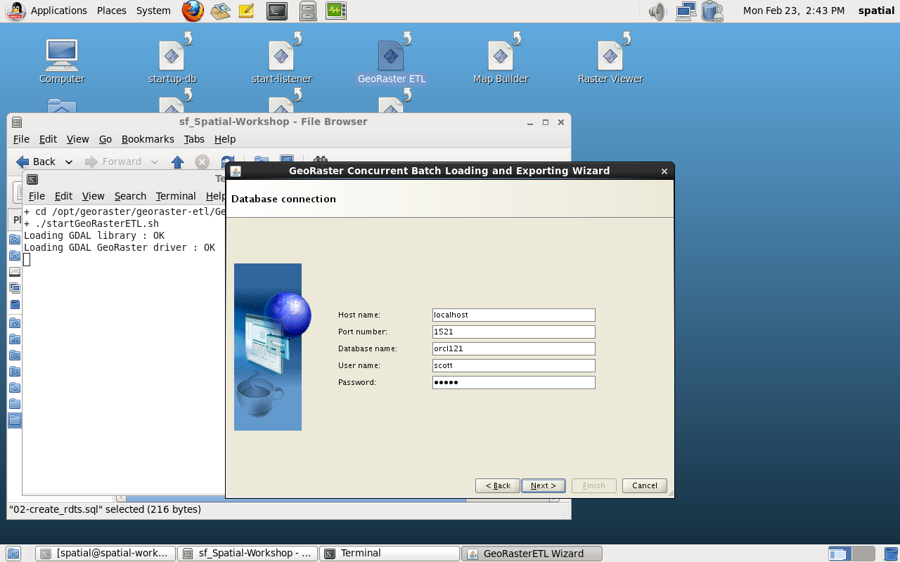
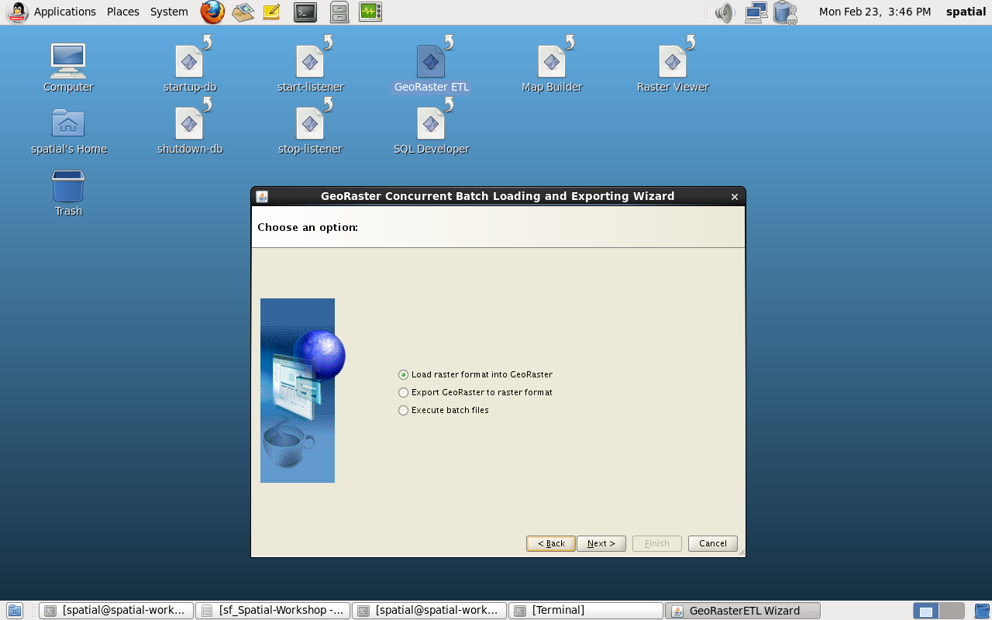
Connect to the Database
12c Release 1

Slide 96
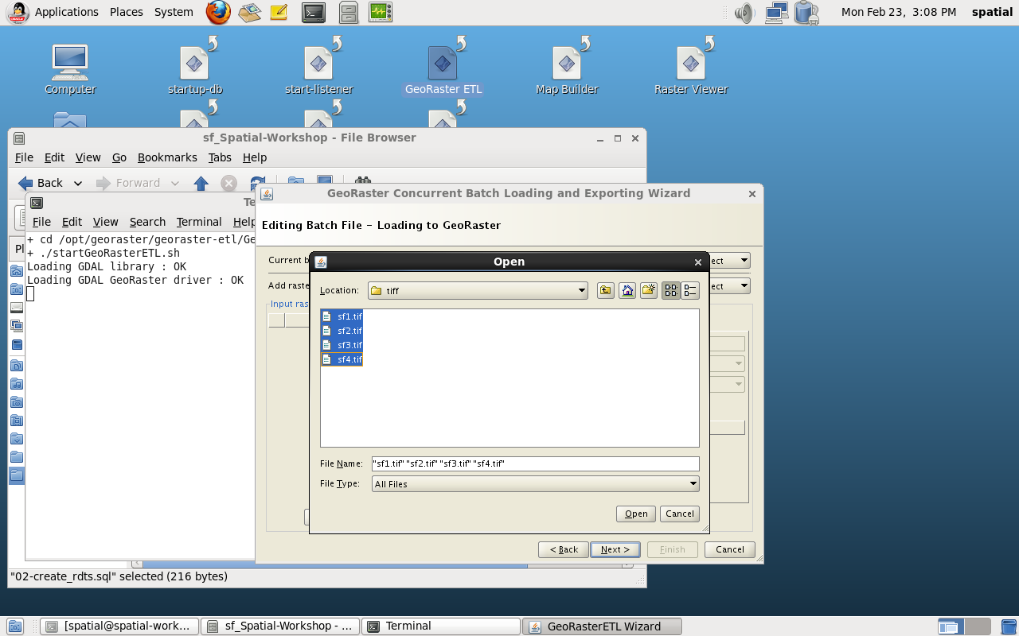
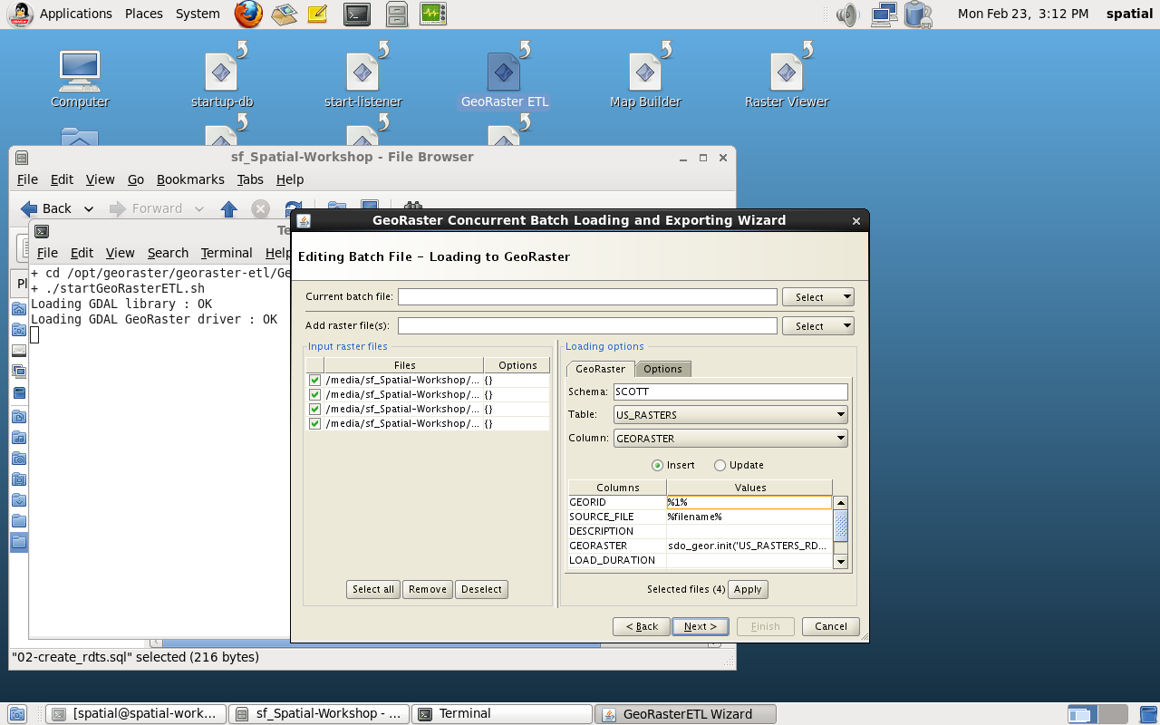
Configure a Raster Import operation
12c Release 1

Slide 97
Variable Column Values
12c Release 1
Use substitution variables in column values
Will be replaced with actual values
%FILENAME% is replaced with the name of the input raster file (without directory)
%n% (where n is a number) is replaced with a number that increments sequentially from n
For example %1001% will generate numbers 1001, 1002, 1003, etc.
Use it to automatically number sequential identifiers (such as GEORID)

Slide 98
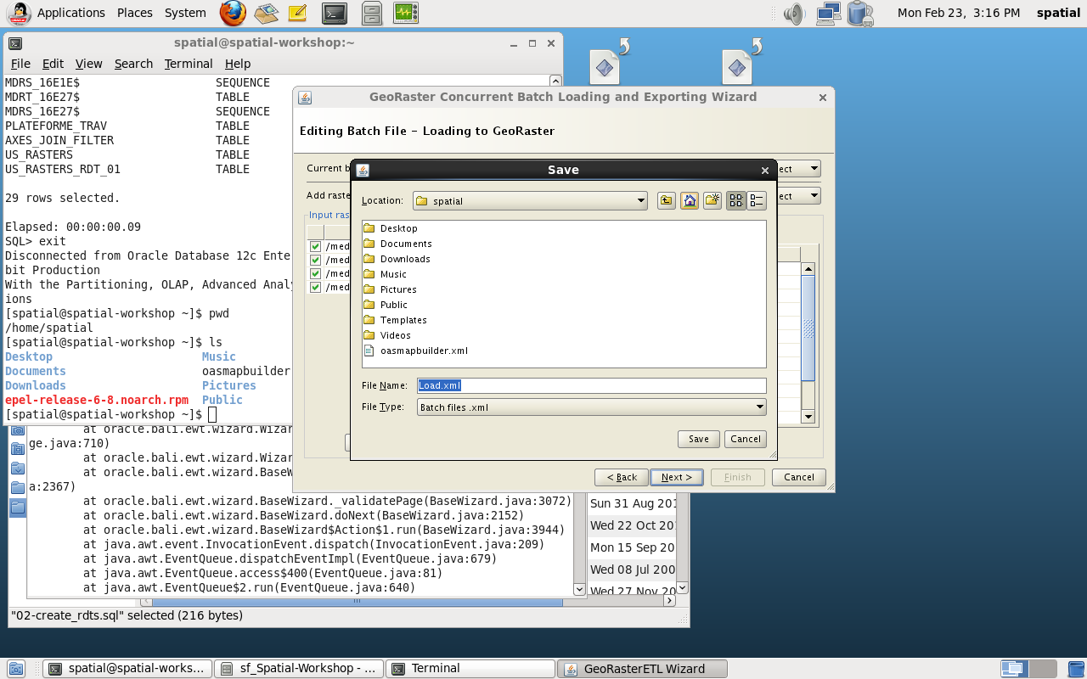
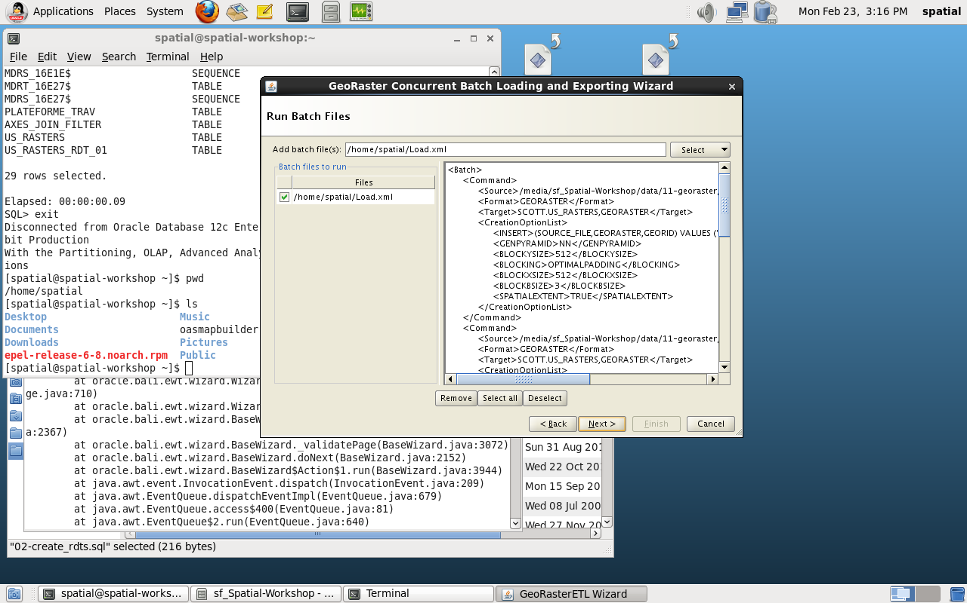
Save the Configuration File
12c Release 1

Slide 99
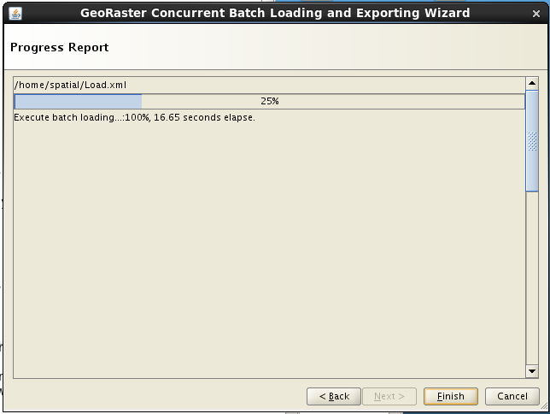
Perform the Load
12c Release 1

Slide 100
Configuration Files
<Batch>
<Command>
<Source>/media/sf_Spatial-Workshop/data/11-georaster/tiff/sf1.tif</Source>
<Format>GEORASTER</Format>
<Target>SCOTT.US_RASTERS,GEORASTER</Target>
<CreationOptionList>
<INSERT>(SOURCE_FILE,GEORASTER,GEORID) VALUES
('sf1.tif',sdo_geor.init('US_RASTERS_RDT_01'))</INSERT>
<GENPYRAMID>NN</GENPYRAMID>
<BLOCKYSIZE>512</BLOCKYSIZE>
<BLOCKING>OPTIMALPADDING</BLOCKING>
<BLOCKXSIZE>512</BLOCKXSIZE>
<BLOCKBSIZE>3</BLOCKBSIZE>
<SPATIALEXTENT>TRUE</SPATIALEXTENT>
</CreationOptionList>
</Command>
...
<Command> ... </Command>
</Batch>

Slide 101
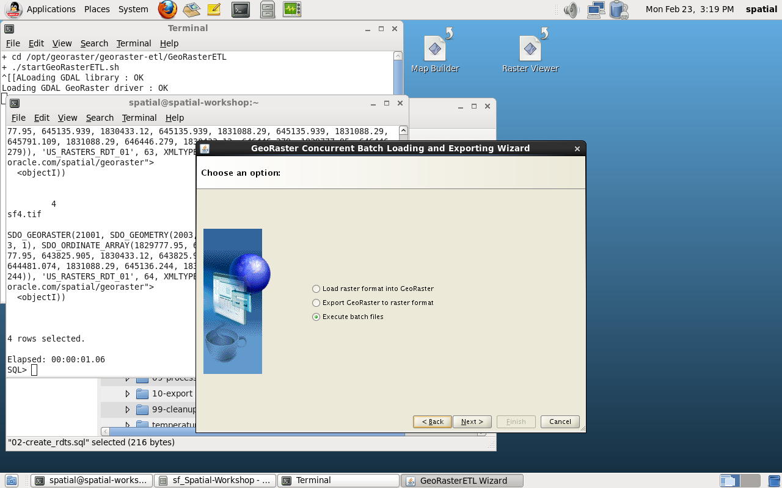
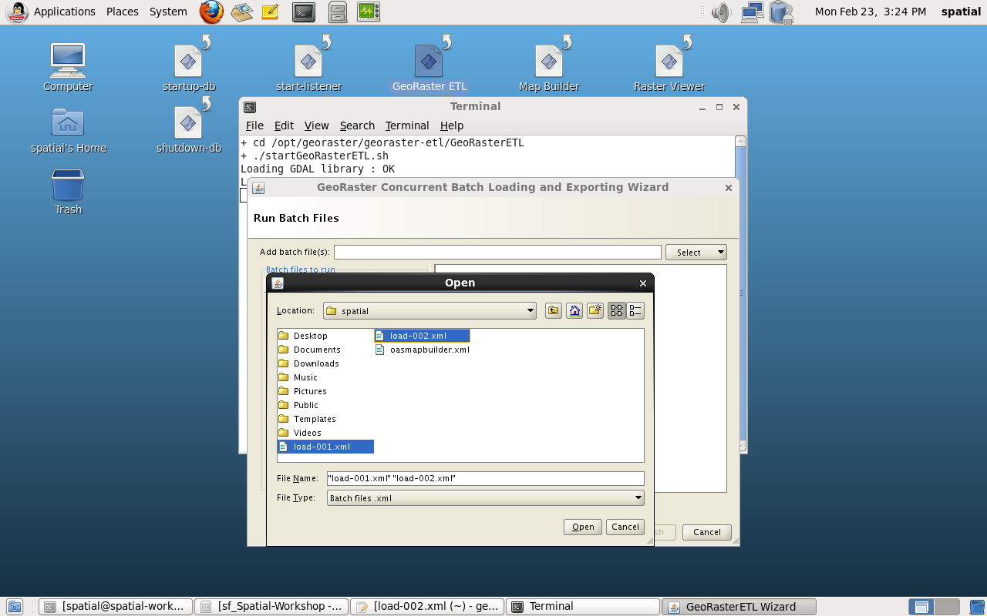
Load Existing Configuration Files
12c Release 1

Slide 102
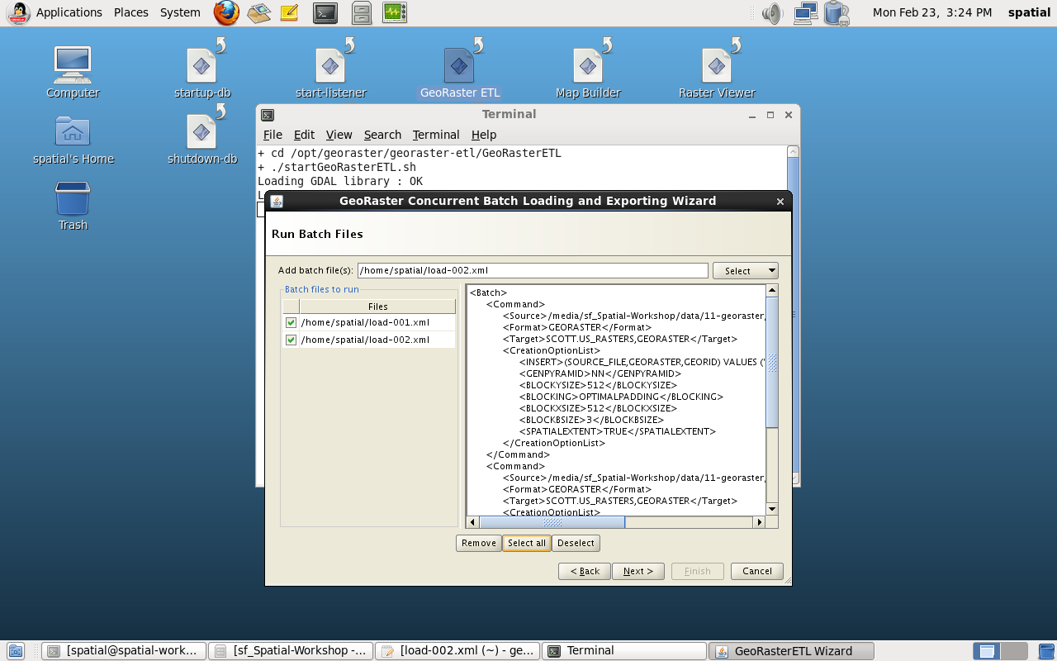
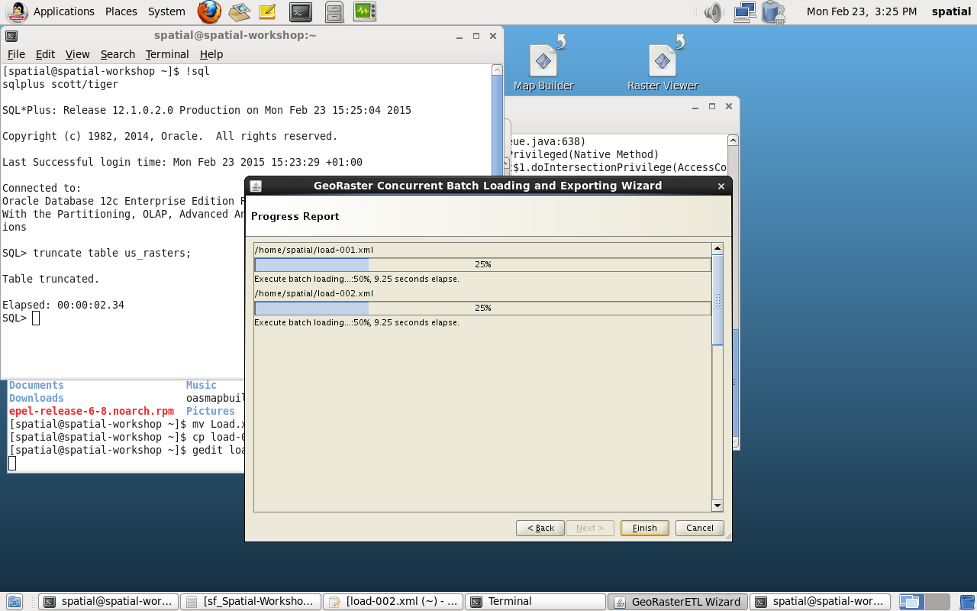
Load Existing Configuration Files
12c Release 1

Slide 103
Configuring and Debugging
12c Release 1
GDAL has a number of configuration options
Set them via environment variables before launching the ETL
GDAL_CACHEMAX = set memory cache
CPL_DEBUG = trace all interactions
See http://trac.osgeo.org/gdal/wiki/ConfigOptions
export GDAL_CACHEMAX=1024
./startGeoRasterETL.sh
set GDAL_CACHEMAX=1024
startGeoRasterETL.sh

Slide 104
<Insert Picture Here>
Load Performance

Slide 105
Understanding Image Structure
Loading a 800 MB GeoTiff
File is compressed LZW
Uncompressed size is 5GB
Loading using GDAL with default blocking (256x256x4) takes … 4 hours!
Loading with a blocking of (256x256x1) takes 4 minutes!
Time is CPU used by gdal_translate

Slide 106
Understanding Image Structure
Check the structure of the input TIFF file:
Image is blocked in very wide very narrow strips
Very costly for the GeoTIFF driver to collect the pixels to fill our blocks!
gdalinfo 129-286.tif
Driver: GTiff/GeoTIFF
Files: D:\Files\Data\129-286.tif
Size is 42252, 31198
...
Band 1 Block=42252x32 Type=Byte, ColorInterp=Red
Band 2 Block=42252x32 Type=Byte, ColorInterp=Green
Band 3 Block=42252x32 Type=Byte, ColorInterp=Blue
Band 4 Block=42252x32 Type=Byte, ColorInterp=Undefined

Slide 107
GDAL and Memory
GDAL uses little memory by default
Set larger caches using GDAL_CACHEMAX option
Loading the 800 MB Tiff with a blocking of (256x256x4) now completes in less than 3 minutes!
gdal_translate -of georaster sf1.tif --config GDAL_CACHEMAX 1024
georaster:scott/tiger@orcl111,us_rasters,georaster
-co blockxsize=512 -co blockysize=512 -co blockbsize=3
-co interleave=bip -co srid=26943
-co "insert=values (1, 'sf1.tif', 'Aerial photo San Francisco 1',
sdo_geor.init('us_rasters_rdt_01', 1),null,null)"

Slide 108
Loading and Compression
Option 1
Load and compress, then generate pyramid
Option 2
Load, then generate pyramid, then compress the result
The second option is more efficient

Slide 109
<Insert Picture Here>
Raster Viewing

Slide 110
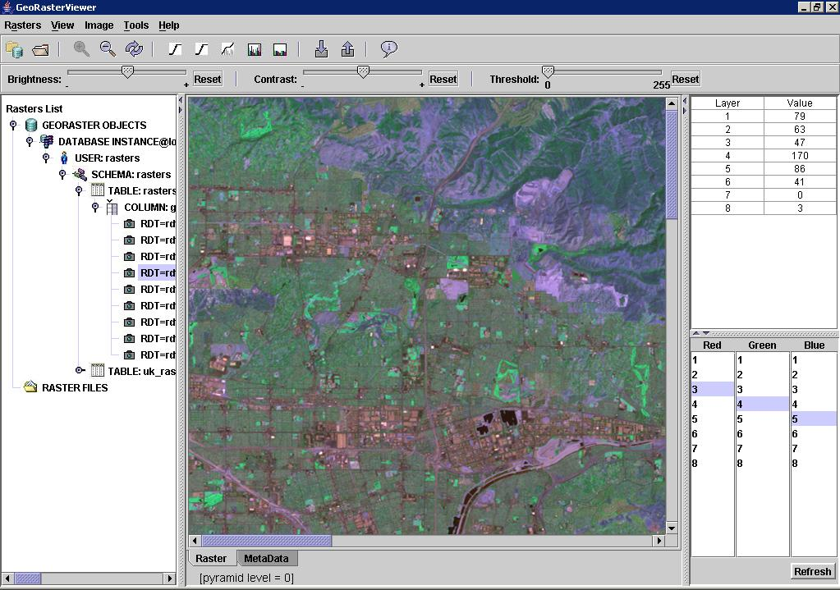

Slide 111
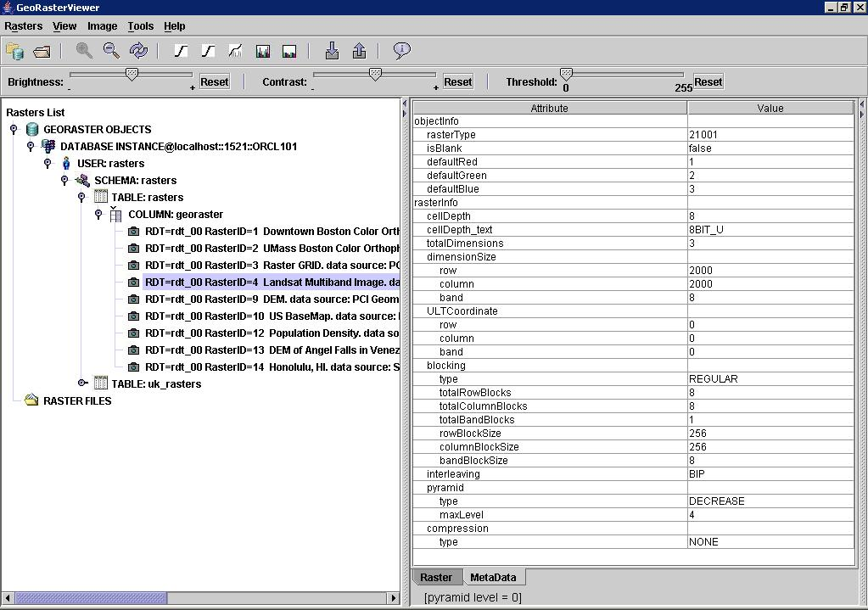

Slide 112
<Insert Picture Here>
Using Rasters

Slide 113
GeoRaster Processing
Insert, update, index, and retrieve raster data and metadata
Generate pyramids
Copy, change format: Interleaving, blocking, Compression
Subsetting: Clip GeoRaster data by band or layer
Scaling: Enlarge or reduce
Tile adjacent images to build a mosaic of the data
Raster Algebra

Slide 114
View Metadata
SQL> set long 32000
SQL> select raster from rasters where id=4;
SDO_GEORASTER(
21001,
SDO_GEOMETRY(2003, NULL, NULL,
SDO_ELEM_INFO_ARRAY(1, 1003, 3),
SDO_ORDINATE_ARRAY(0, 0, 2000, 2000)),
'RDT_14',
4,
XMLTYPE(
<georasterMetadata
xmlns="http://xmlns.oracle.com/
spatial/georaster">
...
</georasterMetadata>
Georeferencing
Raster data table and raster id
Metadata

Slide 115
Extracting Raster Metadata
select id,
sdo_geor.getCellDepth(geoRASTER) cell,
sdo_geor.getBlockSize(geoRASTER) blocksize,
sdo_geor.getInterleavingType(geoRASTER) inter,
sdo_geor.getPyramidMaxLevel(geoRASTER) pyramid,
sdo_geor.getBandDimSize(geoRASTER) bands
from uk_rasters
order by id;
ID CELL BLOCKSIZE INT PYRAMID BANDS
---- ----- ------------------------------ --- ------- -----
1 8 SDO_NUMBER_ARRAY(512, 512) BIP 4 1
...
28 8 SDO_NUMBER_ARRAY(512, 512, 3) BIP 3 3
29 8 SDO_NUMBER_ARRAY(512, 512, 3) BIP 4 3
...
33 8 SDO_NUMBER_ARRAY(512, 512) BIP 4 1
33 rows selected.

Slide 116
Selecting Raster Subsets
Select a subset from layers 1 to 3 as a new raster:
declare
g sdo_georaster;
s sdo_georaster;
begin
select georaster into g
from uk_rasters where georid = 28;
sdo_geor.subset(
inGeoraster => g,
layerNumbers => '1-3',
cropArea =>
sdo_geometry(2003, 8307, null,
sdo_elem_info_array(1, 1003, 3),
sdo_ordinate_array(
-4.8095747, 50.3160369,
-3.4189001, 50.7910561)),
outGeoraster => s);
end;
Selected blocks are cropped and mosaiced into a new raster
raster 28
raster 28 blocks

Slide 117
Selecting Raster Subsets: raw pixels
Select a subset in cell space from pyramid 0, band 0:
Selected blocks are cropped and mosaiced into a BLOB
declare
g sdo_georaster;
b blob;
begin
select georaster into g
from uk_rasters
where georid = 28;
dbms_lob.createTemporary(b, true);
sdo_geor.getRasterSubset(
geoRaster => g,
pyramidLevel => 0,
window => sdo_number_array(0,0,699,899),
bandNumbers => '0',
rasterBlob => b);
end;
raster 28
raster 28 blocks

Slide 118
Exporting using GDAL
gdal_translate -of jpeg
georaster:scott/tiger@orcl111,us_rasters,georaster,georid=1
sf1.jpg
-co worldfile=YES
-of jpeg | Use JPEG output
georaster:scott/tiger@orcl111 | Database connection
us_rasters,georaster | Destination table and column
georid=1 | WHERE clause to select the raster to export
sf1.jpg | Name of output JPEG file
-co worldfile=YES | Produce a world file with georeferencing information

Slide 119
Exporting using Java command line GeoRasterExporter
java -Xms900M -Xmx900M GeoRasterExporter
127.0.0.1 orcl101 1521
georaster georaster
thin 32 T
rasters raster
"1,UK_RASTERS_RDT_1“
"JPEG“
raster_1_p0_0_0.500_500
"pLevel=0,cropArea=(0,0,500,500)"
JDBC connection parameters
Table and column
Raster id
Output format
Output file name
Reformating

Slide 120
Database-driven Export exportTo()
declare
g sdo_georaster;
begin
select georaster into g from us_rasters
where georid = 1;
sdo_geor.exportTo(
g,
'pLevel=0,cropArea=(0,0,500,500)',
'TIFF', 'file', '/usr/rasters/sf1s.tif',
'WORLDFILE', 'file', '/usr/rasters/sf1s.tfw',
);
end;
Read Raster
Reformating
Output file name and format
Can also export to a BLOB (worldfile in a CLOB)

Slide 121
<Insert Picture Here>
12c Release 1
Raster Algebra and Analytics

Slide 122
What is Raster Algebra
Raster Algebra (Map Algebra) is a set-based algebra for manipulating geographic raster data, proposed by Dr. Dana Tomlin in the early 1980s. It’s widely used for cartographic modeling and spatial analysis.
It includes a set of primitive algebraic operators applied on one or more raster layers of similar dimensions to produce one or more new raster layers or other values.
There are 4 types of operations: local, focal, zonal and global.
It provides a procedural or scripting language enabling very complex operations
However, all implementations are different.

Slide 123
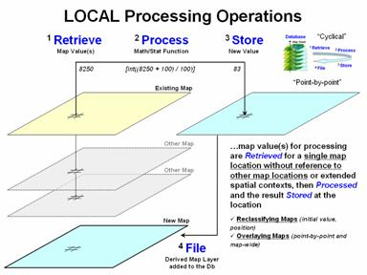
Local Raster Algebra Operations
Local raster algebra applies the same operation point-by-point for each cell location of the input raster layers.
Z = (X+500)/(Y+100)
where X, Y are input raster layers. Z is the output layer
(Local operations use point-by-point processing of map values that occur at each map location. Source: Joseph K. Berry, Beyond Mapping III)

Slide 124
Raster Algebra and Analytics Engine
The Raster Algebra Language is provided as an extension to PL/SQL
Supports local raster algebra only in this release
It includes an expression language for raster algebra operators
general arithmetic, casting, logical and relational operators
It includes 4 raster algebra functions
cell value based conditional queries; cell value based conditional updates; arithmetic operations; raster classification/segmentation
Polygon clipping based statistics generation functions to support interactive analysis on-the-fly, which are considered as focal/zonal/global functions.

Slide 125
Raster Algebra and Analytics Engine
Raster Algebra Language includes an expression language and four functions of Map Algebra:
Cell-value based conditional queries: searches/masks cells based on boolean expression
Cell-value based updates: update cells of a raster-based on boolean expression
Arithmetic operations on cell values: ADD, DIVIDE, LOG, etc.
Classification for raster segmentation: applies arithmetic expression to cells and then segments the raster
Polygon clipping based statistics generation functions, to support interactive analysis on-the-fly

Slide 126
The Raster Algebra Language
An Extension to the PL/SQL Language
PL/SQL provides
declaration of variables and constants
general expressions and functions
statements
Programs
GeoRaster provides
raster algebra operators/expressions
raster algebra functions

Slide 127
Searching For Cells
A Sample Application of Raster Algebra
Select all cells for which the value of band 0 is between 10 and 50, band 1 is between 100 and 150 and band 2 is between 200 and 245
declare
geor1 SDO_GEORASTER; -- source 3-band image
geor2 SDO_GEORASTER; -- result 3-band image
begin
select georaster into geor1 from georaster_table where georid = 1;
select georaster into geor2 from georaster_table where georid = 2;
sdo_geor_ra.findcells (
geor1,
'({0}>=10&{0}<50)&({1}>=100&{1}<150)&({2}>200&{2}<245)',
null, geor2, null, 'false','parallel=4'
); update georaster_table set georaster = geor2 where georid = 2;
end;

Slide 128
The Raster Algebra Expressions
Elements are variables, constants, operators (boolean, comparison or arithmetic), and functions
Variables refer to the values of cells in the raster(s) to process
Form is {r,b} or {b}
{2,0} refers to band 0 of the third input raster (for functions that operate on multiple rasters)
{1} refers to band 1 in the only input raster
Constants are any number (integer or decimal)
0, 255, 0.44556,-273.15 are all valid numbers

Slide 129
The Raster Algebra Expressions
Arithmetic Operators are what you expect:
+, -, *, /
Comparison Operators:
>, <, =, !=, <=, >=
Boolean Operators:
&, |, !
Usual precedence rules for operators apply
Use parentheses to force the order
Boolean expressions return 0 or 1

Slide 130
The Raster Algebra Expressions
Functions:
abs, sqrt, exp, log, ln, sin, cos, tan, sinh, cosh, tanh, arcsin, arccos, arctan, ceil, floor
Apply to any arithmetic expression
Casting a cell value to a specific data type:
Useful when converting between different cell depths
For example from 32BIT_FLOAT to 8BIT_UNSIGNED
castint, castonebit, casttwobit, castfourbit, casteightbit
Apply to any arithmetic expression

Slide 131
The Raster Algebra Expressions
An expression applies to all cells in the input rasters
Input rasters must be coherent:
Same row and column dimensions,
Same geographical area.
Can have different cell depth and different number of bands

Slide 132
The Raster Algebra Expressions
For example: ({0}+{1}+{2})/3 applies to all cells in the input raster.
It computes the average of the values in bands 0, 1 and 2 for each cell.
Same for boolean expressions: {0,1}>{1,1}*1.10 applies the comparison to all cells of the two input rasters.
It returns “true” when the value in band 1 in the first raster is more than 10% larger than the same value in the second raster
(actually returns 1 for “true” and 0 for “false”)

Slide 133
The Raster Algebra Expressions
arithmeticExpr:
unaryArithmeticExpr
| binaryArithmeticExpr
| functionArithmeticExpr
| booleanExpr
| castingExpr
| constantNumber
| identifier
| (arithmeticExpr)
booleanExpr:
unaryBooleanExpr
| binaryBooleanExpr
| arithmeticExpr comparisonOp
arithmeticExpr
| (booleanExpr)
unaryArithmeticExpr:
(arithmeticUnaryOp arithmeticExpr)
binaryArithmeticExpr:
arithmeticExpr arithmeticBinaryOp
arithmeticExpr)
functionArithmeticExpr:
numericFunction (arithmeticExpr)
castingExpr:
rangeType (arithmeticExpr)
unaryBooleanExpr:
booleanUnaryOp booleanExpr
binaryBooleanExpr:
booleanExpr booleanBinaryOp booleanExpr
arithmeticBinaryOp:
+
| -
| *
| /
comparisonOp:
=
| <
| >
| >=
| <=
| !=

Slide 134
The Raster Algebra Expressions
arithmeticUnaryOp:
+
| -
booleanBinaryOp:
&
| |
booleanUnaryOp:
!
rangeType:
castint
| castonebit
| casttwobit
| castfourbit
| casteightbit
numericFunction:
abs
| sqrt
| exp
| log
| ln
| sin
| cos
| tan
| sinh
| cosh
| tanh
| arcsin
| arccos
| arctan
| ceil
| floor
constantNumber:
double number
identifier:
{ID,band}
| {band}
ID:
integer number
band:
integer number

Slide 135
The Raster Algebra Functions
sdo_geor_ra.findCells | Selects cells based on a boolean expression
sdo_geor_ra.rasterUpdate | Updates cells of a raster based on a boolean expression
sdo_geor_ra.rasterMathOp | Performs arithmetic operations
sdo_geor_ra.classify | Applies arithmetic operations to cells and then segments the raster

Slide 136
Cell Value-Based Conditional Queries
sdo_geor_ra.findCells
Condition
Input Raster
Output Raster
findCells
Select all cells from the input raster that match the boolean condition
Copy them into the output raster
Other cells in the output raster are set to a chosen fixed value
The output raster has the same structure as the input raster (same bands, same cell depth)

Slide 137
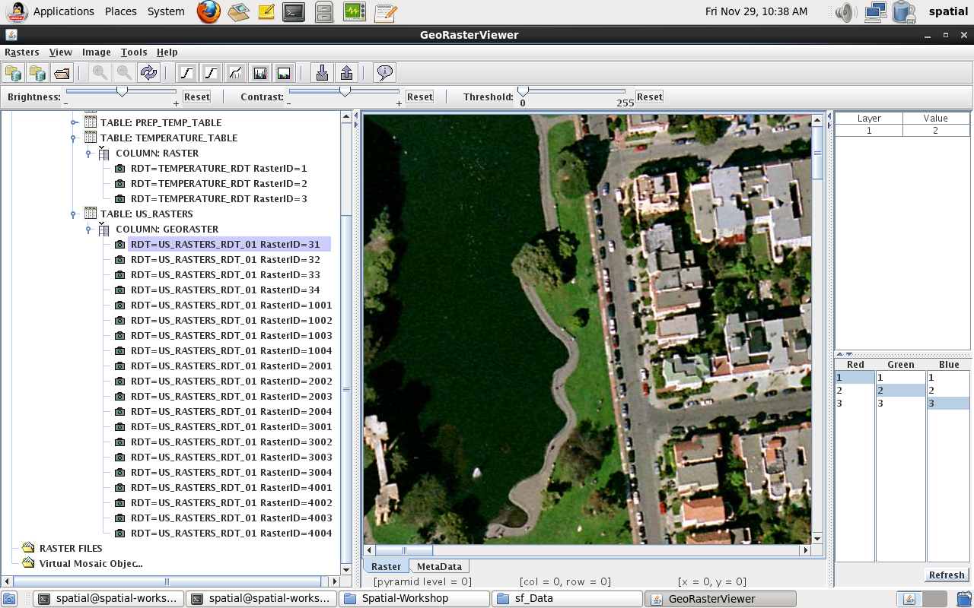
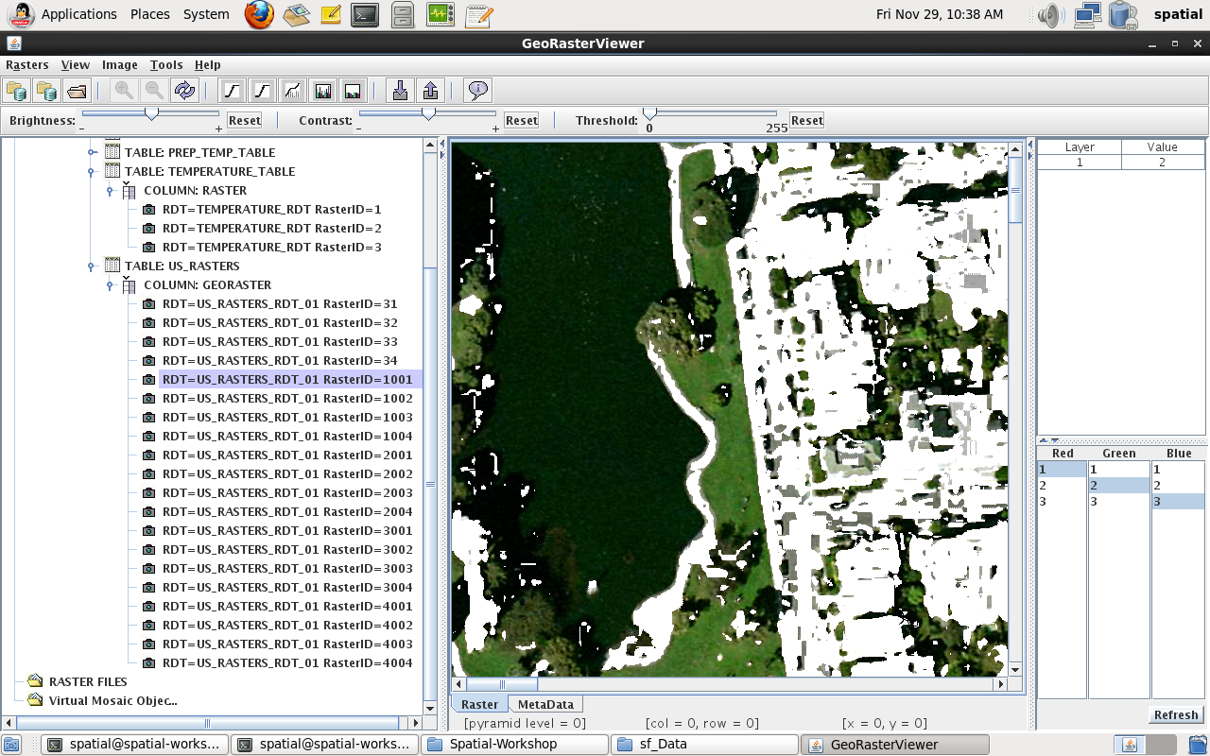
findCells example
Input is a 3-band RGB color image
Find all cells from the input raster where green dominates
Value of band 1 is greater than value of band 0 and value of band 2
Other cells set to white
sdo_geor_ra.findCells (
inGeoraster => gr1,
condition => '{1}>={0}&{1}>={2}',
storageParam => null,
outGeoraster => gr2,
bgValues => sdo_number_array (255,255,255)
);

Slide 138
Cell Value-Based Conditional Updates (Edits)
sdo_geor_ra.rasterUpdate
Conditions
Input / Output Raster
rasterUpdate
Values
a, b, c, d, e
a, b, c, d, e
There can be one or more input conditions
Each condition is associated with a set of numeric values
Select the cells from the input raster that match each of the boolean conditions
When matched, replace its value(s) from the corresponding value(s) provided
Values can be constants or RA expressions!

Slide 139
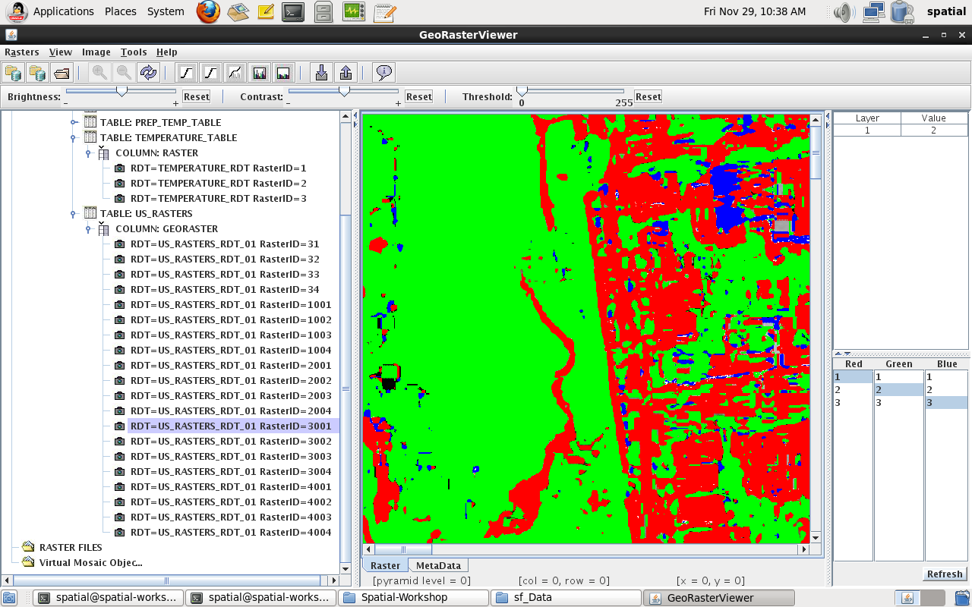
rasterUpdate example
Input is a 3-band RGB color image
Replace cells with their dominant color
e.g. when red dominates, set to red
sdo_geor_ra.rasterUpdate (
georaster => gr1,
pyramidLevel => null,
conditions => sdo_string2_array(
'({0}>{1})&({0}>{2})', -- Red dominates
'({1}>{0})&({1}>{2})', -- Green dominates
'({2}>{0})&({2}>{1})’ -- Blue dominates
),
vals => sdo_string2_arrayset(
sdo_string2_array('255','0','0'),
sdo_string2_array('0','255','0'),
sdo_string2_array('0','0','255')
)
);
Those could also be RA expressions

Slide 140
Mathematical Operations
sdo_geor_ra.rasterMathOp
Operations
Input Rasters
Output Raster
rasterMathOp
There are one or several input operations (arithmetic expressions)
There are one or several input rasters and one output raster
Apply each operation to the input raster(s)
Write the result into one of the bands of the output raster
The output raster has one band per operation

Slide 141
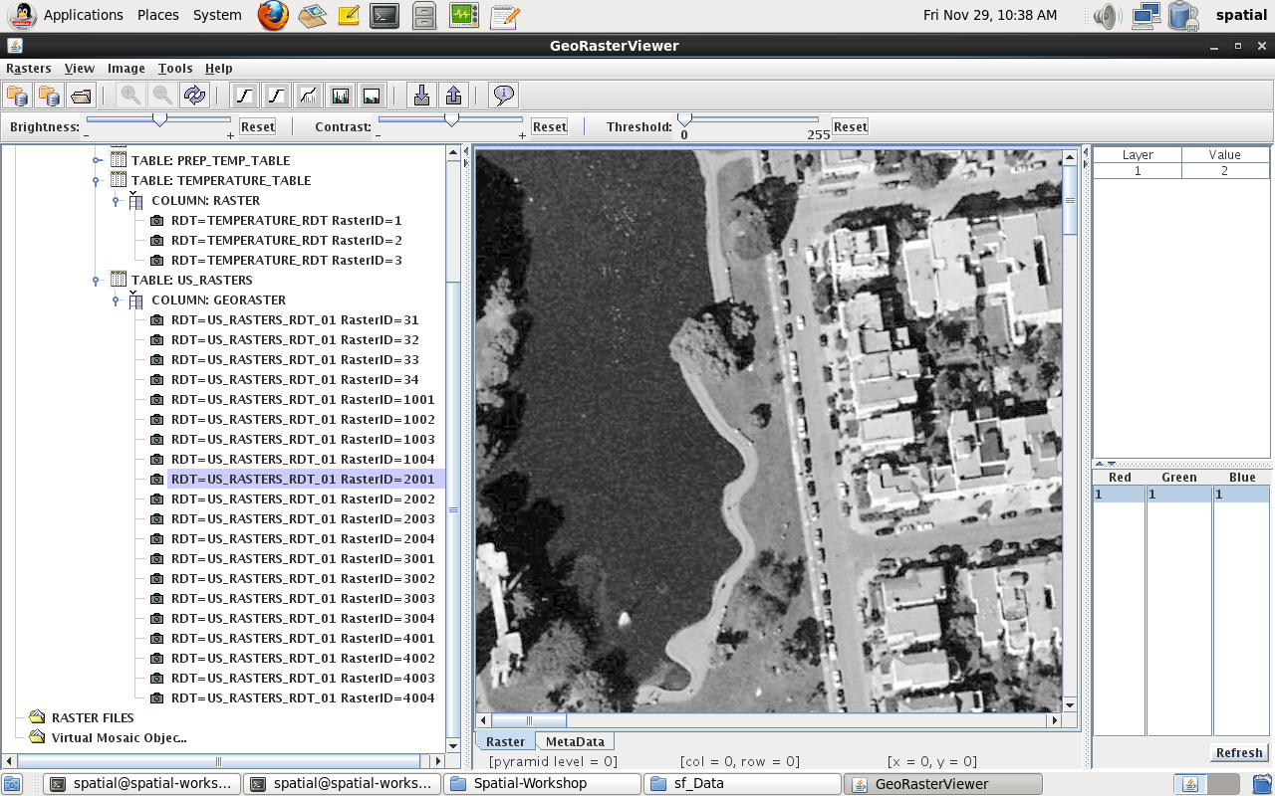
rasterMathOp example
Input is a 3-band RGB color image
Create new single band raster in grayscale
Compute new cells as the average of red, green and blue pixels
sdo_geor_ra.rasterMathOp (
inGeoraster => gr1,
operation => sdo_string2_array('({0}+{1}+{2})/3'),
outGeoraster => gr2,
storageParam => null
);

Slide 142
Classification Operations
sdo_geor_ra.classify
Input Rasters
Expression
classify
Output Raster
Range Array
Value Array
Apply the expression on the input rasters
Lookup the result in the Range Array
Write the corresponding value from the Value Array in the output raster.

Slide 143
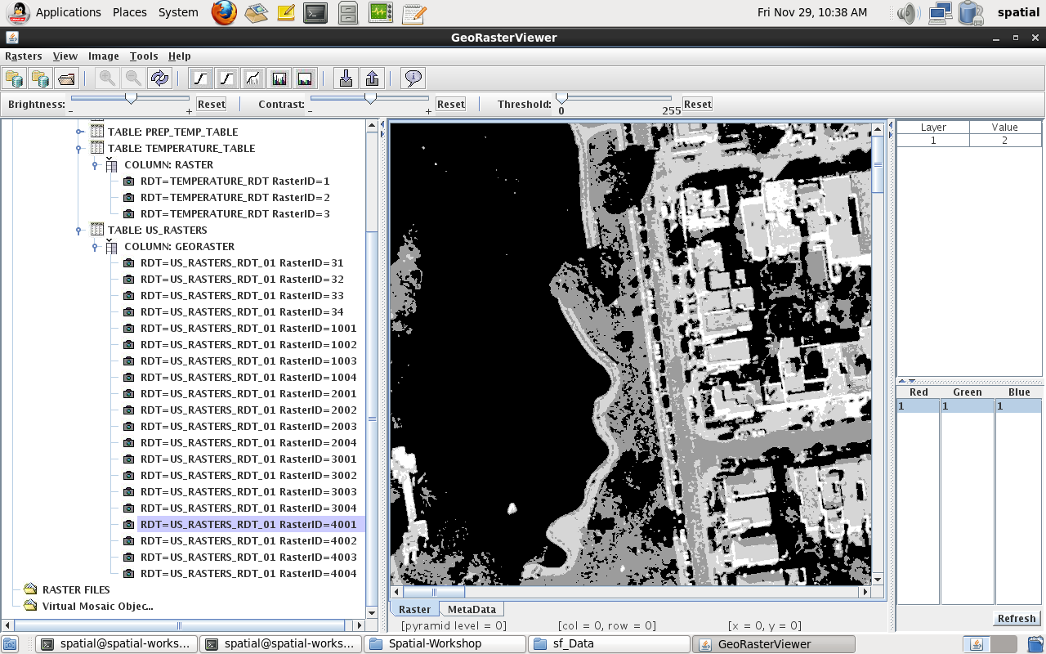
classify example
333333330000123322310
333333332211233222122
333331122112332221212
333311201100112221230
333000332211233233312
333311231121111222123
333333302211233220022
333333002211233222121
222122100221123322212
Input is a 3-band RGB color image
Classify cells in four groups based on the average of the red, green and blue pixels
Output is a single-band raster with a cell depth of 2 bits.
From | To | Group
0 | 63 | 0
64 | 127 | 1
128 | 191 | 2
192 | 255 | 3
sdo_geor_ra.classify (
inGeoraster => gr1,
expression => '({0}+{1}+{2})/3',
rangeArray => SDO_NUMBER_ARRAY(63,127,191),
valueArray => SDO_NUMBER_ARRAY(0,1,2,3),
outGeoraster => gr2,
storageParam => 'cellDepth=2BIT'
);

Slide 144
Historical Temperature Analysis
A more complex example
A collection of 33 years of global temperature data for each month. In total, 396 layers stored in one georaster object:
1. The values are in Kelvin, which is converted to Fahrenheit
2. Generate the Average (mean) temperature for each month
3. Compute the Mean Absolute Deviation per Month (the mean difference from the average across 33 years for each month).
use PL/SQL program to generate all expressions on the left and execute the rasterMathOp operations.
-- converting Kelvin to Fahrenheit
'({0}-273.15)*9/5+32’
-- compute average temperature for a month (January)
'({0}+{12}+{24}+{36}+{48}+{60}+{72}+{84}+{96}+{108}+{120}+{132}+{144}+{156}+{168}+{180}+{192}+{204}+{216}+{228}+{240}+{252}+{264}+{276}+{288}+{300}+{312}+{324}+{336}+{348}+{360}+{372}+{384})/33’
-- compute mean absolute deviation for a month (January)
‘(abs({1,0}-{0,0})+abs({1,0}-{0,12})+abs({1,0}-{0,24})+abs({1,0}-{0,36})+abs({1,0}-{0,48})+abs({1,0}-{0,60})+abs({1,0}-{0,72})+abs({1,0}-{0,84})+abs({1,0}-{0,96})+abs({1,0}-{0,108})+abs({1,0}-{0,120})+abs({1,0}-{0,132})+abs({1,0}-{0,144})+abs({1,0}-{0,156})+abs({1,0}-{0,168})+abs({1,0}-{0,180})+abs({1,0}-{0,192})+abs({1,0}-{0,204})+abs({1,0}-{0,216})+abs({1,0}-{0,228})+abs({1,0}-{0,240})+abs({1,0}-{0,252})+abs({1,0}-{0,264})+abs({1,0}-{0,276})+abs({1,0}-{0,288})+abs({1,0}-{0,300})+abs({1,0}-{0,312})+abs({1,0}-{0,324})+abs({1,0}-{0,336})+abs({1,0}-{0,348})+abs({1,0}-{0,360})+abs({1,0}-{0,372})+abs({1,0}-{0,384}))/33'

Slide 145
Use PL/SQL to generate expressions
operation sdo_string2_array := sdo_string2_array();
-- Generate raster algebra operations to convert all bands from Kelvin to Fahrenheit
-- One operation per band b
-- Each operation looks like this:
-- ({b}-273.15)*9/5+32
-- where b is the band number, from 0 to 395
operation.Extend(numBands);
for b in 1 .. numBands loop
operation(i) := '({' || ( b - 1 ) || '}-273.15)*9/5+32';
end loop;
SDO_GEOR_RA.rasterMathOp(
inGeoRaster => gr5,
operation => operation,
storageParam => null,
outGeoraster => gr6,
nodata => 'TRUE',
nodataValue => -9999
);

Slide 146
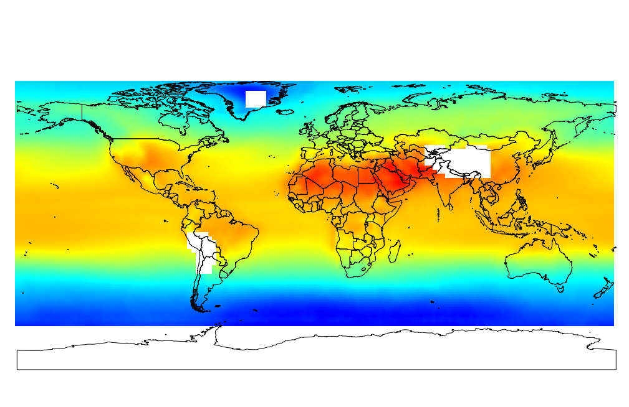
Historical Temperature Analysis: Average
June Average Temperature over 33 Years
(Source Temperature Data Courtesy of Remote Sensing Systems - http://www.remss.com/)

Slide 147
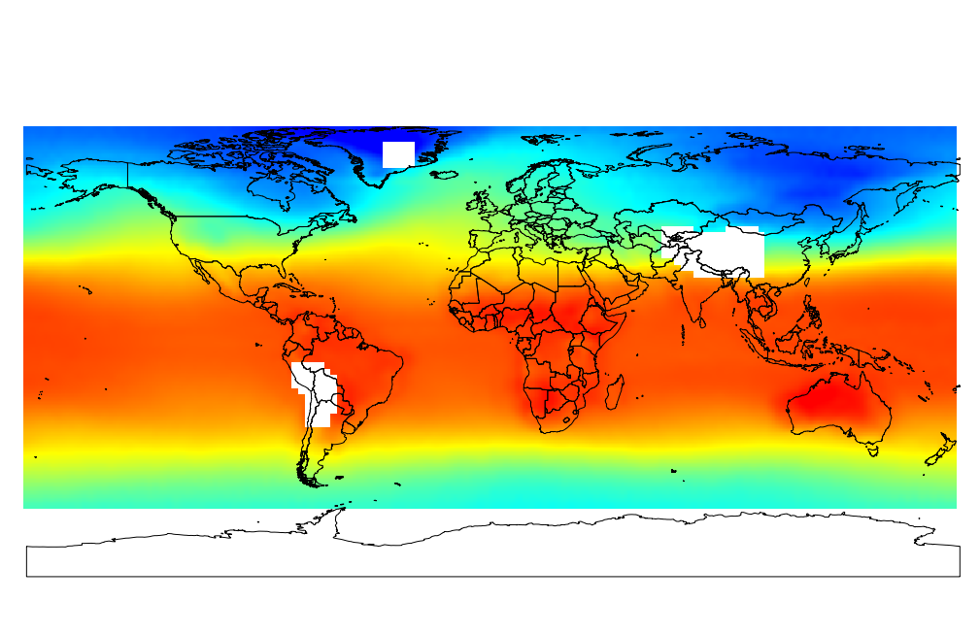
Historical Temperature Analysis: Average
December Average Temperature over 33 Years
(Source Temperature Data Courtesy of Remote Sensing Systems - http://www.remss.com/)

Slide 148
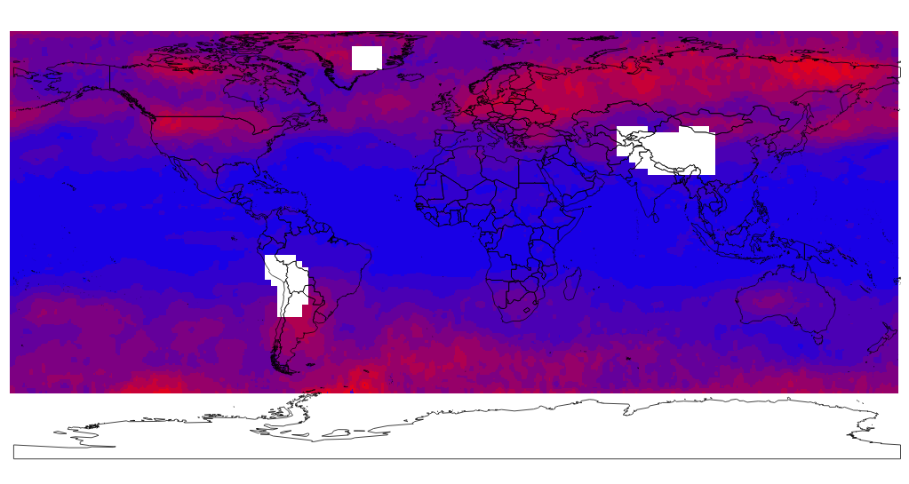
Historical Temperature Analysis: Anomaly
June Temperature Mean Absolute Deviation Analysis
(Source Temperature Data Courtesy of Remote Sensing Systems - http://www.remss.com/)

Slide 149
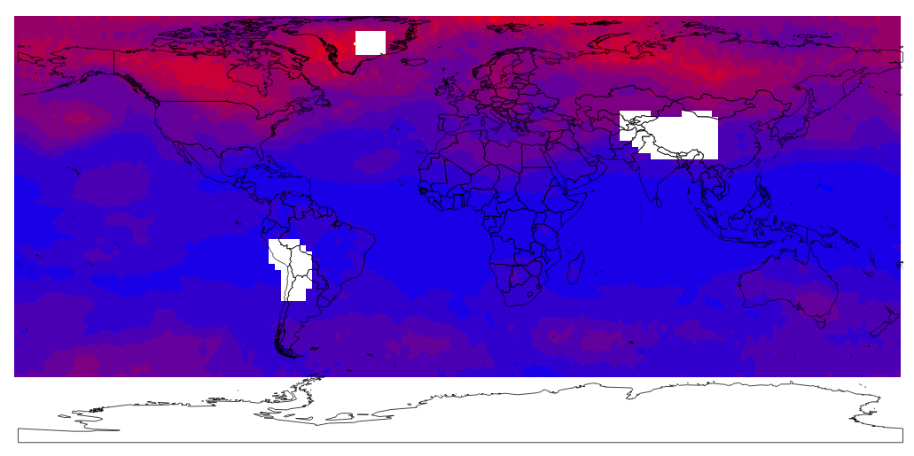
Historical Temperature Analysis: Anomaly
December Temperature Mean Absolute Deviation Analysis
(Source Temperature Data Courtesy of Remote Sensing Systems - http://www.remss.com/)

Slide 150
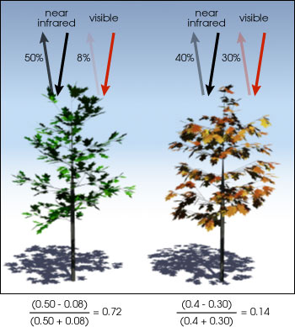
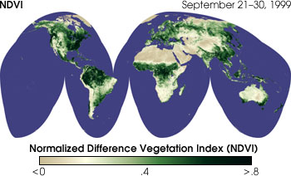
NDVI Computation
Normalized Difference Vegetation Index
A widely used index, enabling users to quickly identify vegetated areas and monitor the growth and condition of plants.
Calculated from the visible and near-infrared light reflected by vegetation.
NDVI = (NIR — VIS)/(NIR + VIS)
Values range from -1.0 to 1.0:
water ~ -1.0
barren area ~ 0.0
shrub/grass ~ 0.2-0.4
forest ~ 1.0
Images courtesy of NASA Earth Observation

Slide 151
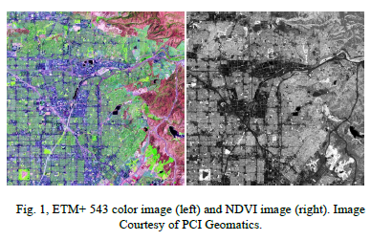
NDVI Computation
Normalized Difference Vegetation Index
ETM+543 false color image
For Landsat Thematic Mapper (TM) imagery, the standard NDVI computation formula is: (TM4 - TM3) / (TM4 + TM3).
Implement using Oracle raster algebra:
sdo_geor_ra.rasterMathOp (
inGeoraster => gr1,
operation =>
sdo_string2_array(
'({3}-{2})/({3}+{2})'),
outGeoraster => gr2,
storageParam => 'celldepth=32bit_real'
);
NVDI image
Images courtesy of PCI Geomatics

Slide 152
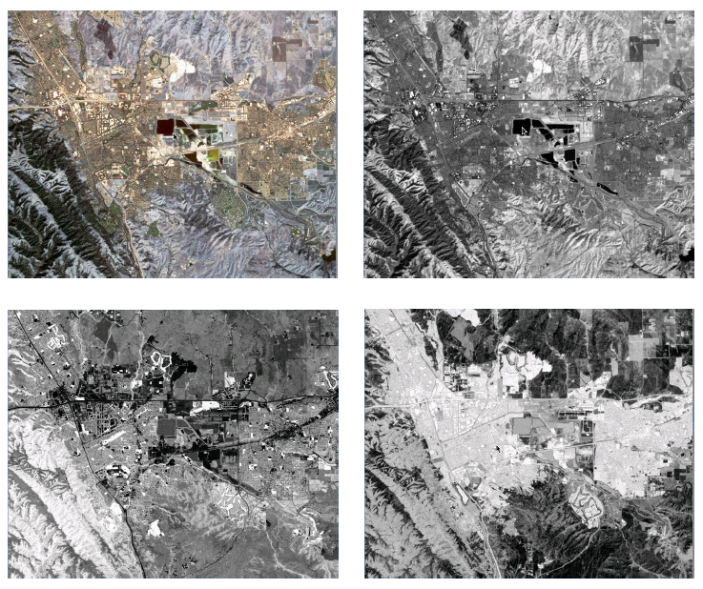
Tasseled Cap Transformation (TCT)
Bands of an image converted into a new set of bands with defined interpretations that are useful for vegetation mapping.
Each tasseled-cap band is created by the sum of image band 1 * a coefficient + image band 2 * a coefficient etc…
Coefficients are derived statistically from images and empirical observations.
Source TM 123 Color Image (upper left), Brightness (upper right), Greenness (lower left) and Wetness (lower right). Landsat 5 TM Image Courtesy of the U.S. Geological Survey

Slide 153
Tasseled Cap Transformation
Example
sdo_geor_ra.rasterMathOp (
inGeoraster => gr1,
operation => sdo_string2_array(
'0.3561*{0}+0.3972*{1}+0.3904*{2}+0.6966*{3}+0.2286*{4}+0.1596*{6}',
'(-0.3344)*{0}-0.3544*{1}-0.4556*{2}+0.6966*{3}-0.0242*{4}-0.2630*{6}',
'0.2626*{0}+0.2141*{1}+0.0926*{2}+0.0656*{3}-0.7629*{4}-0.5388*{6}',
'0.0805*{0}-0.0498*{1}+0.1950*{2}-0.1327*{3}+0.5752*{4}-0.7775*{6}',
'(-0.7252)*{0}-0.0202*{1}+0.6683*{2}+0.0631*{3}-0.1494*{4}-0.0274*{6}',
'0.4000*{0}-0.8172*{1}+0.3832*{2}+0.0602*{3}-0.1095*{4}+0.0985*{6}’
),
outGeoraster => gr2,
storageParam => 'celldepth=32bit_real'
);

Slide 154
Cartographic Modeling
A Hypothetical Analytical Model
expr := '((100<{0,0})&({0,0}<=500))&(({1,0}=3)|({1,0}=10))&(((({2,0}+{3,0})*log({4,0})/sqrt({4,0}))>={5,0})|({6,0}!=1))’;
sdo_geor_ra.rasterMathOp (
inGeoRasters => my_cursor,
operation =>
sdo_string2_array(expr),
outGeoraster => gr2,
storageParam => 'celldepth=1bit'
nodata => 'TRUE',
nodataValue => 0,
parallelParam => ’parallel=4'
);
Assume that a hypothetical cartographic model involves 7 different raster layers (stored in 7 georasters) and has an expression as follows:
if (100 < layer1 <= 500) &
(layer2 == 3 or layer2 == 10) &
((((layer3+layer4) * log(layer5) / sqrt(layer5)) >= layer6) or (layer7 != 1) )
then output = 1
else output = 0

Slide 155
<Insert Picture Here>
12c Release 1
Image Processing and Virtual Mosaic

Slide 156
Image Processing and Virtual Mosaic
Advanced Large-Scale Image Mosaicking
Large-Scale Image Appending
Virtual Mosaic
Rectification and Orthorectification
Image Masking
Image Stretching
Image Segmentation

Slide 157
Advanced Large-Scale Mosaicking
sdo_geor_aggr.mosaicSubset
A complete new implementation, parallelized and scalable
Source images can be tables, views or a SQL statement
Source images can be rectified or unrectified or in different CS
Support internal resampling, reprojection or rectification
Supports gaps, no data, and overlapping regions
Support 8 common point rules (max, min, avg, LATEST, OLDEST ...)
User defined priority for overlapping regions (Date or SQL ORDER BY)
Simple color balancing (linear stretch and normalization)
Notes:
START: The value from the first encountered GeoRaster object is used.
END: The value from the last encountered GeoRaster object is used.
LATEST: The value from the GeoRaster object that has the most recent EndDataTime in the metadata is used.
OLDEST: The value from the GeoRaster object that has the oldest EndDataTime in the metadata is used.
CTC: The value from the GeoRaster object that is closest to the center of the output window is used.
HIGH: The maximum cell value of all the overlapping GeoRaster objects is used.
LOW: The minimum cell value of all the overlapping GeoRaster objects is used.
AVERAGE: The average of all cell values from the overlapping GeoRaster objects is used.

Slide 158
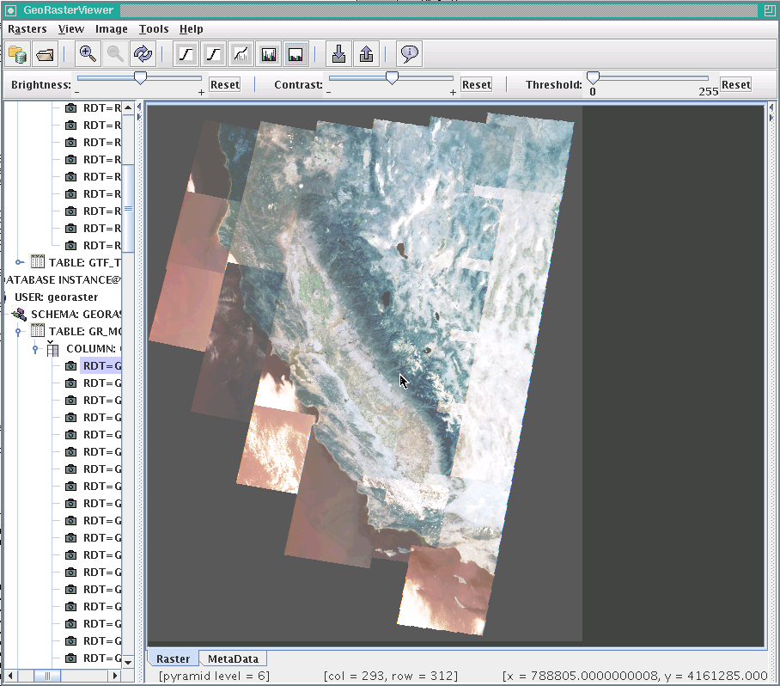
An Example – Mosaic of Landsat Images
Source images:
31 Landsat 5 Level 1T TM images, from the U.S. Geological Survey.
The total size of the image set is 11.9 GB.
15 images are in UTM zone 11N
16 images are in UTM zone 10N projection.
They overlap each other.
Output mosaic:
about 7.7GB in size

Slide 159
Large-Scale Appending
sdo_geor_aggr.append to update existing image with new ones
Used to append or update a large physical mosaic using newly acquired smaller images
The source image can be on ANY SIDE of the target image!
Same functionality as mosaicking:
Source images can be rectified or unrectified or in different CS
Support internal resampling, reprojection or rectification
Supports gaps, no data, and overlapping regions
Support 8 common point rules (max, min, avg, LATEST, OLDEST, etc...)
Simple color balancing (linear stretch and normalization)
Notes:
START: The value from the first encountered GeoRaster object is used.
END: The value from the last encountered GeoRaster object is used.
LATEST: The value from the GeoRaster object that has the most recent EndDataTime in the metadata is used.
OLDEST: The value from the GeoRaster object that has the oldest EndDataTime in the metadata is used.
CTC: The value from the GeoRaster object that is closest to the center of the output window is used.
HIGH: The maximum cell value of all the overlapping GeoRaster objects is used.
LOW: The minimum cell value of all the overlapping GeoRaster objects is used.
AVERAGE: The average of all cell values from the overlapping GeoRaster objects is used.

Slide 160
Virtual Mosaic
An Advanced Image Query and Image Serving Engine
A virtual mosaic is defined as any large collection of georeferenced GeoRaster objects (images) that is treated as if it is a single GeoRaster object (physical mosaic).
Three ways to define a virtual mosaic:
a list of GeoRaster tables
a database view with a GeoRaster column
a SQL query statement (i.e., a CURSOR)
A virtual mosaic can contain unlimited number of images of any size
There is no need to define a description file for the virtual mosaic

Slide 161
Virtual Mosaic
To query or process the virtual mosaic, use:
sdo_geor_aggr.getMosaicSubset
to perform on-the-fly cropping queries over the virtual mosaic
sdo_geor_aggr.mosaicSubset
to perform a query and store the mosaicked subset as a GeoRaster object
To facilitate application development, call:
sdo_geor_aggr.validateForMosaicSubset
sdo_geor_aggr.getMosaicExtent
sdo_geor_aggr.getMosaicResolution

Slide 162
Virtual Mosaic
Same functionality as large-scale mosaicking
Source images can be rectified or unrectified or in different CS
Support internal resampling, reprojection or rectification
Supports gaps, no data, and overlapping regions
Support 8 common point rules (max, min, avg, LATEST, OLDEST, etc...)
User defined priority for overlapping regions (Date or SQL ORDER BY)
Simple color balancing (linear stretch and normalization)

Slide 163
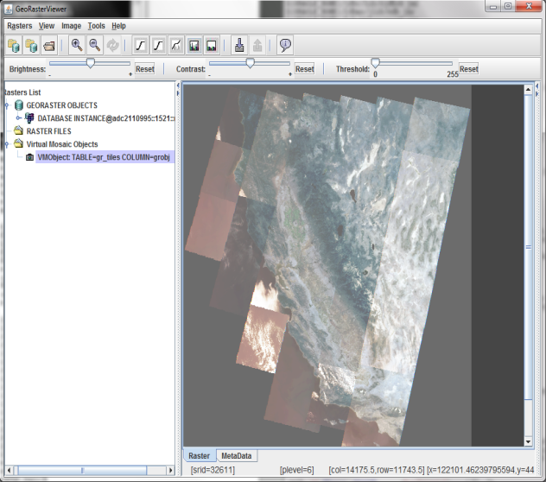
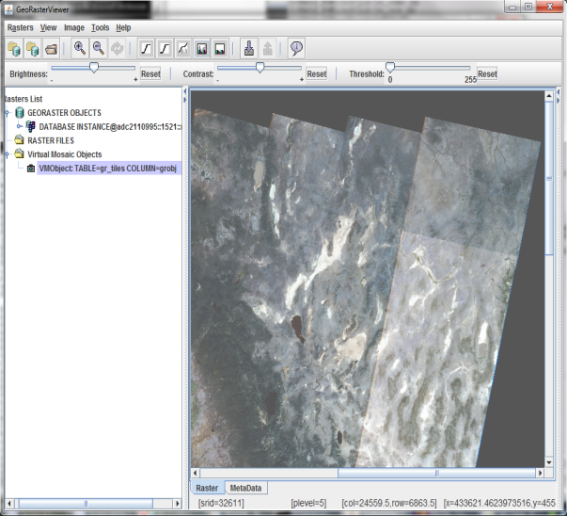
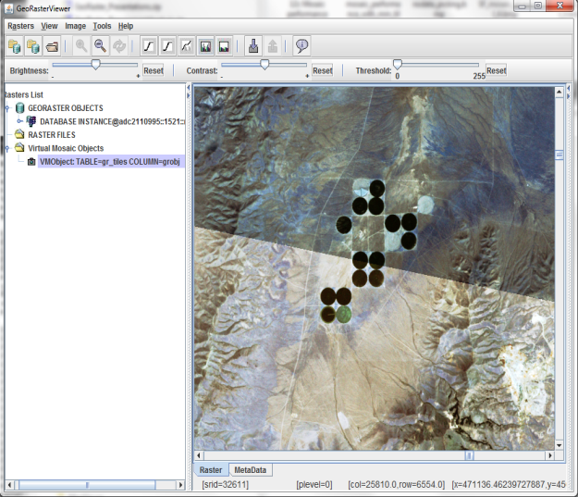
An Example - Virtual Mosaic
Overview
Zoom In
Zoom In Further
(Image Courtesy of the U.S. Geological Survey)

Slide 164
Some Virtual Mosaic Use Cases
DOQs can be stored as is - but used as seamless mosaic (as fast as physical mosaics)
Users may not want to mosaic DEM’s
Store large volume of imagery without making too many extra copies (save disk spaces)
New images coming in and immediately displayed on the mosaic (dynamic updates)
The same images can be displayed or removed in different virtual mosaics (flexible model)

Slide 165
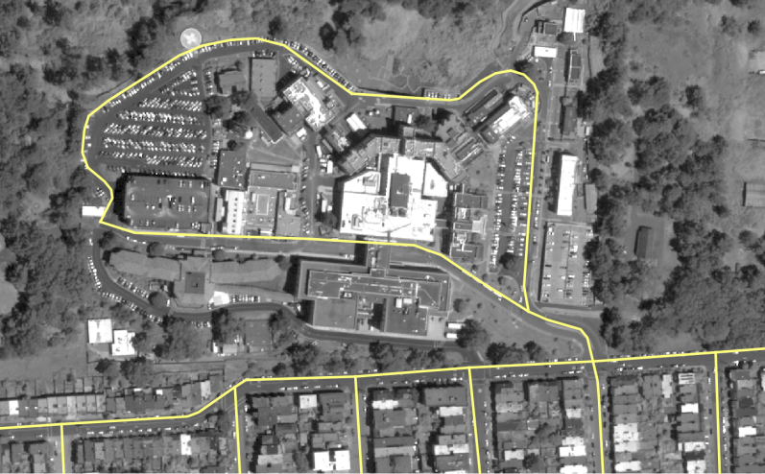
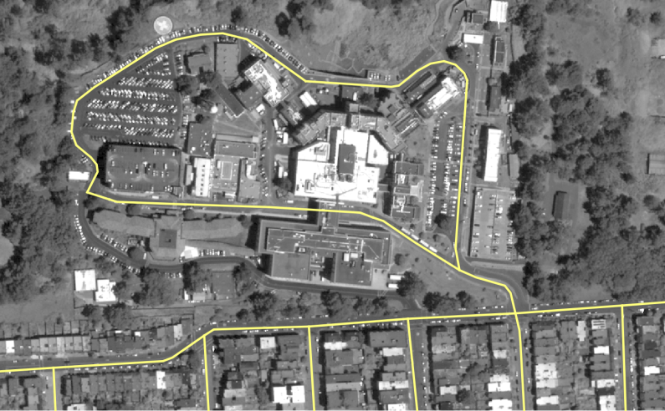
Image Rectification and Orthorectification
Rectification of georeferenced raw images
Orthorectification of georeferenced raw image using DEM
Both support on-the-fly cropping queries or for persistent storage
rectify
(Image Courtesy of Digital Globe)

Slide 166
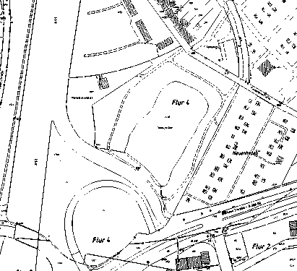
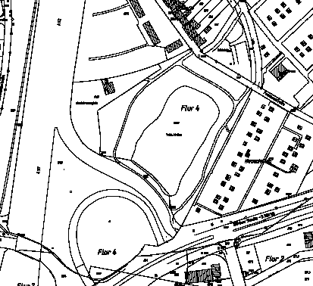
New Bitmap Pyramiding
A new algorithm to pyramid bit raster maps
Preserve point or line features and avoid dash lines
Useful for rasterized point, line or polyline features
Old Pyramid
(with missing and dash lines)
New Pyramid
(no dash lines)
(Map Data Courtesy of G.ON)

Slide 167
More Image Processing
Image Stretching
Image Segmentation
Image Masking

Slide 168
<Insert Picture Here>
Managing Raster Structures

Slide 169
Dropping Raster Tables
Cannot drop a RDT if it contains blocks for existing rasters:
First delete the objects, truncate the raster table or drop it
drop table us_rasters_rdt_01
*
ERROR at line 1:
ORA-00604: error occurred at recursive SQL level 1
ORA-13391: The referenced raster data table(RDT) cannot be dropped.
ORA-06512: at "MDSYS.MD", line 1723
ORA-06512: at "MDSYS.MDERR", line 17
ORA-06512: at line 1
ORA-06512: at line 188
SQL> delete from us_rasters;
4 rows deleted.
SQL> drop table us_rasters_rdt_01;
Table dropped.

Slide 170
Raster Metadata
Check views USER_SDO_GEOR_SYSDATA or ALL_SDO_GEOR_SYSDATA
Lists all the rasters in your schema or in all schemas
Name Null? Type
--------------------- -------- ----------------------
OWNER NOT NULL VARCHAR2(32)
TABLE_NAME NOT NULL VARCHAR2(32)
COLUMN_NAME NOT NULL VARCHAR2(1024)
METADATA_COLUMN_NAME VARCHAR2(1024)
RDT_TABLE_NAME NOT NULL VARCHAR2(32)
RASTER_ID NOT NULL NUMBER
OTHER_TABLE_NAMES MDSYS.SDO_STRING_ARRAY

Slide 171
Checking for Errors
select * from table( SDO_GEOR_ADMIN.checkSysdataEntries );
This function reports the following errors:
The RDT name is not unique.
The GeoRaster table does not exist.
The GeoRaster column does not exist.
The GeoRaster object does not exist.
The GeoRaster object is non-empty or nonblank, but the RDT does not exist.
Duplicate GeoRaster objects exist (that is, one or more non-unique combinations of RDT and raster ID)

Slide 172
Fixing Errors
Fixes errors reported by SDO_GEOR_ADMIN.checkSysdataEntries()
Check for any « dangling » raster blocks
Blocks in an RDT that are not used by any georaster object
DECLARE
corrected_errors SDO_STRING2_ARRAY;
BEGIN
corrected_errors:= sdo_geor_admin.MaintainSysdataEntries;
for i in 1..corrected_errors.count loop
dbms_output.put_line(corrected_errors(i));
end loop;
END;
/

Slide 173
Checking for Errors
Check for any « dangling » RDTs
RDT not used by any georaster object
Check for any « dangling » raster blocks
Blocks in an RDT that are not used by any georaster object
select * from table(SDO_GEOR_ADMIN.listUnregisteredRDT);
select * from table( SDO_GEOR_ADMIN.listDanglingRasterData );

Slide 174
Solving RDT name conflicts
Names of RDT tables must be globally unique
Cannot have two RDTs with the same name in different schemas
To rename an RDT:
This renames the table and updates all georaster objects.
EXECUTE sdo_geor_utl.renameRDT(
'US_RASTERS_RDT_01', 'US_RASTERS_RDT_02');

Slide 175
Moving Rasters between Databases
Use export and import tools
EXP/IMP or EXPDP/IMPDP
Export the raster table(s) as well as the RDT(s).
Import into new database or schema
Must specifically exclude the DML triggers automatically created by Georaster (or just ignore the creation errors)
expdp scott/tiger directory=DATA_PUMP_DIR
dumpfile=us_rasters.dmp
tables=(us_rasters, us_rasters_rdt_01)
impdp scott/tiger directory=DATA_PUMP_DIR
dumpfile=us_rasters.dmp
tables=(us_rasters, us_rasters_rdt_01)
exclude=trigger:\"like 'GRDMLTR%'\"

Slide 176
Moving Rasters between Databases
Use transportable tablespaces
EXPDP/IMPDP
« Export » the tablespace(s)
« Import » into new schema
Register the raster objects
expdp system/manager directory=DATA_PUMP_DIR
dumpfile=us_rasters_ts.dmp
transport_tablespaces=us_rasters_ts
impdp system/manager directory=DATA_PUMP_DIR
dumpfile=us_rasters_ts.dmp
transport_datafiles=(us_rasters_ts01.dbf,us_rasters_ts02.dbf)
EXECUTE sdo_geor_admin.registerGeoRasterObjects;

Slide 177
<Insert Picture Here>
Java API

Slide 178
Java API
Provides helper functions for Georaster access in java
Package oracle.spatial.georaster
Classes:
JGeoRaster Maps to the SDO_GEORASTER type
JGeoRasterMeta Deals with raster metadata
JRaster Retrieve raster data
GeoRasterImage Retrieve raster for visualization
SdoGeorPKG Access PL/SQL APIs in package SDO_GEOR
Fully functional examples with source code
Loader
Exporter
Viewer

Slide 179
Fetching Rasters
// Construct SQL query
String sqlQuery = "SELECT GEORASTER FROM US_RASTERS WHERE GEORID=1"
// Execute query
Statement stmt = dbConnection.createStatement();
OracleResultSet rs = (OracleResultSet)stmt.executeQuery(sqlQuery);
// Fetch results
while (rs.next()) {
// Extract JDBC object from record into structure
STRUCT dbObject = (STRUCT) rs.getObject(1);
// Import from structure into Geometry object
JGeoRaster geor = new JGeoRaster (dbObject);
}

Slide 180
Fetching Raster Data
// Get JRaster object to fetch raster content
JRaster jr = geor. getRasterObject();
// Get one raster block
Byte[] rb = jr.getRasterBlock (
pyramidLevel, bandBlockNumber, rowBlockNumber,
columnBlockNumber);
// Get entire raster data
BLOB rd = jr.getRasterData (pyramidLevel);
columnBlockNumber);
// Get a subset of a raster
Byte[] rsub = jr.getRasterSubset (
pyramidLevel, window, layerNo, cellDepth, compression);

Slide 181
<Insert Picture Here>
Georaster Support

Slide 182











Third party Geo-Raster support
Safe Software - FME
PCI Geomatics - Geomatica
Bentley Maps
Intergraph
ESRI - ArcGIS (ArcGIS 9.2)
Erdas – ADE, Titan, Apollo
Autodesk Map and Mapguide (via GDAL ?)
Cadcorp
LizardTech – SpatialExpress – MrSID, JPEG2000 plugin
eSpatial – iSmart
Abaco - DbMAP ASJ
Luciad Map
Skyline Software – TerraSuite

Slide 183





Open Source Geo-Raster support
GDAL library and tools
MapServer (via GDAL)
gvSIG (via GDAL)
GeoTools library and tools (Java)
GeoServer (via its Geotools)

